Slide 1
Vapor Compression Refrigeration
Leveraging Phase Changes in Saturated Systems to Provide Cooling
David Sellers
Senior Engineer, Facility Dynamics Engineering

Slide 2
An Air Cooled Vapor Compression Cycle Chiller

Slide 3
An Air Cooled Vapor Compression Cycle Chiller
Start with a heat exchanger; a.k.a the evaporator

Slide 4
An Air Cooled Vapor Compression Cycle Chiller
Start with a heat exchanger; a.k.a the evaporator
Add the fluid you want to cool on one side of the heat transfer surface

Slide 5
An Air Cooled Vapor Compression Cycle Chiller
Refrigerant
  Substance used to absorb heat from the item or area to be cooled
  Vapor compression cycles leverage the latent heat of vaporization of the refrigerant
    Energy that changes the liquid to a vapor
    The evaporator functions as a saturated system
Start with a heat exchanger; a.k.a the evaporator
Place a refrigerant on the other side of the heat transfer surface
Add the fluid you want to cool on one side of the heat transfer surface

Slide 6

Phase Changes and Saturated Systems

Slide 7

Phase Changes and Saturated Systems

Slide 8

Phase Changes and Saturated Systems

Slide 9

Phase Changes and Saturated Systems

Slide 10
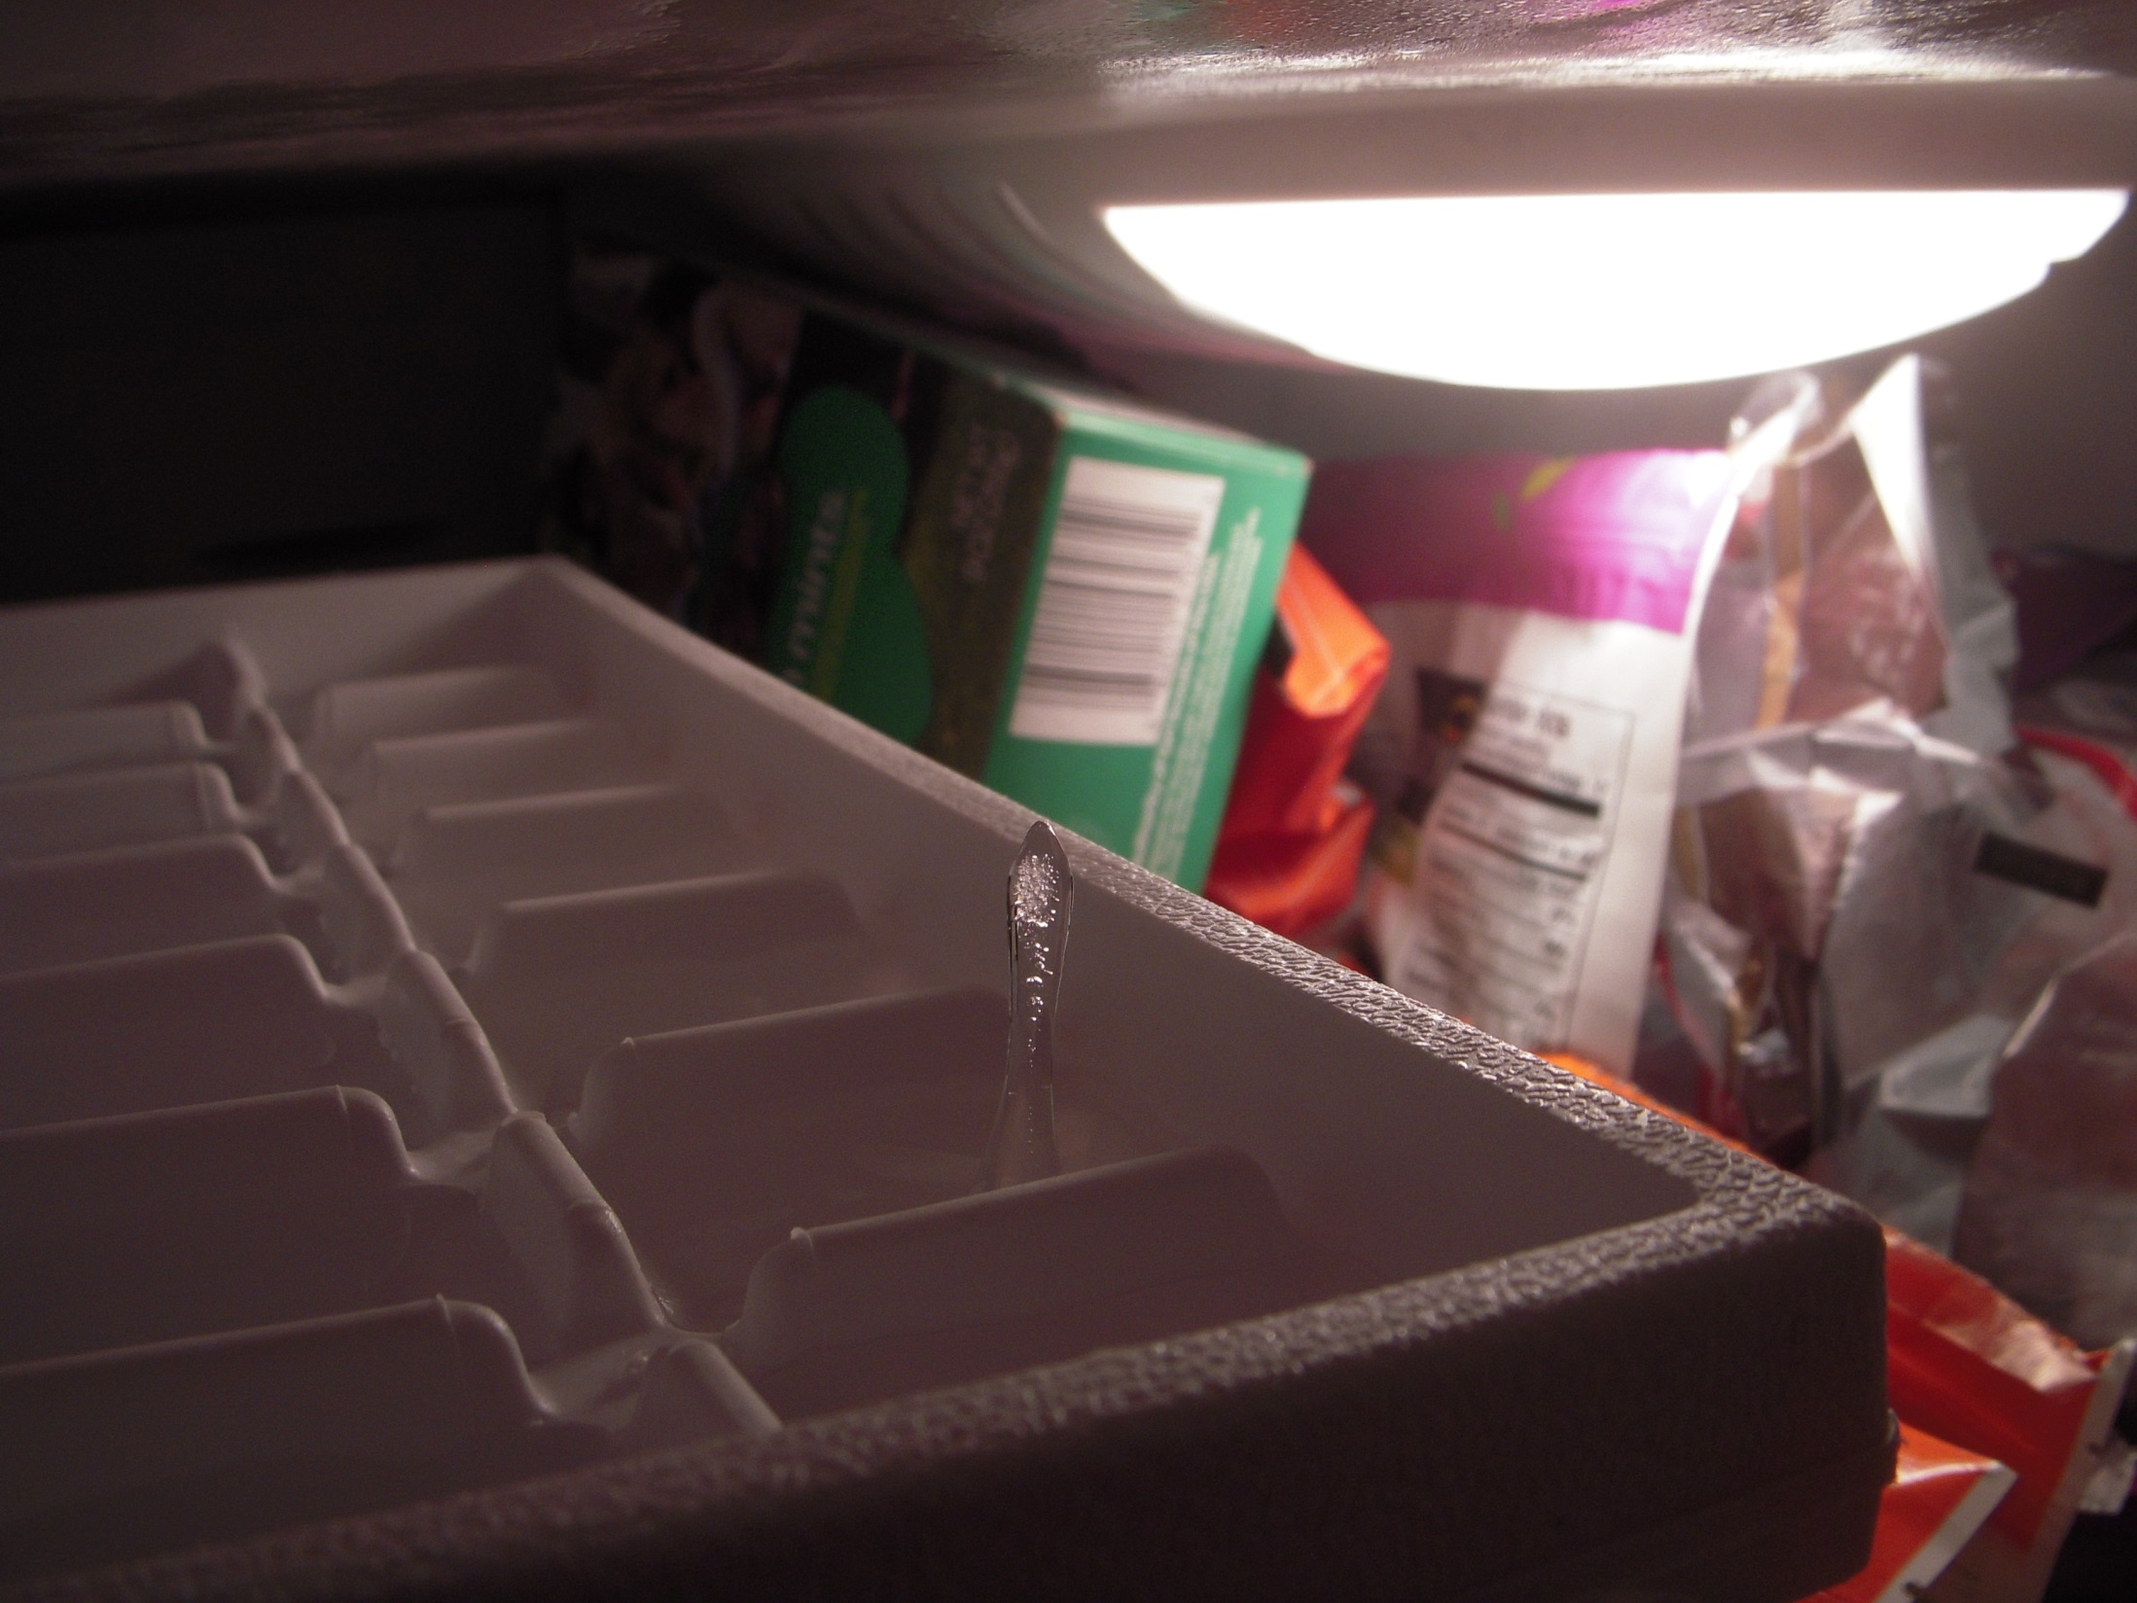
Phase Changes and Saturated Systems

Slide 11
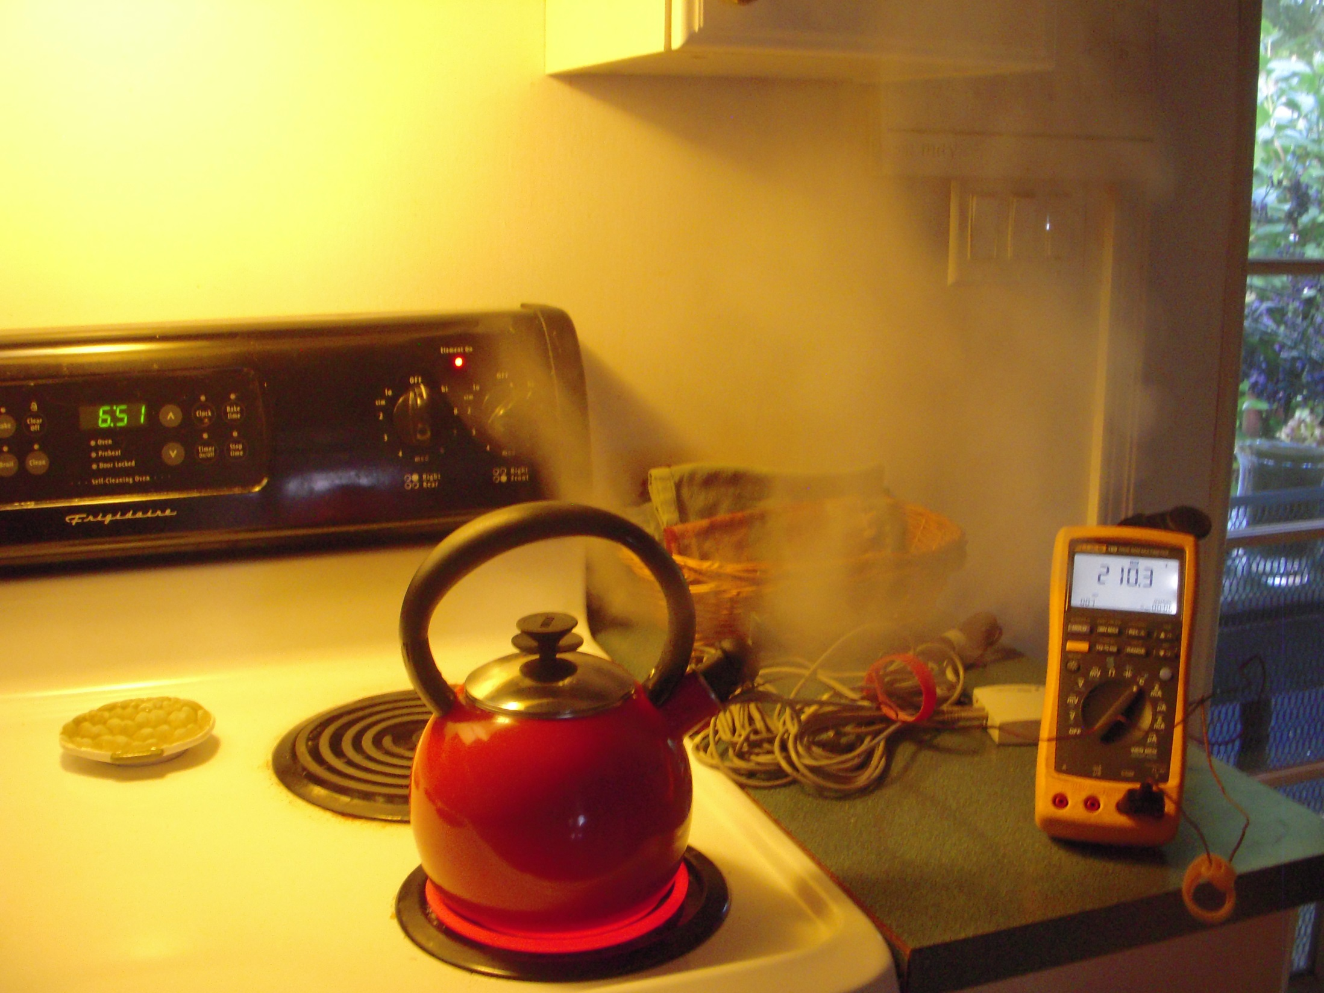
Phase Changes and Saturated Systems

Slide 12
Phase Changes and Saturated Systems
Phase changes absorb a lot of energy
  Melting ice – 144 Btu/lb
  Heating water – 1Btu/lb-°F
  Converting water to steam – 971 Btu/lb
  Superheating steam – 0.5 Btu/lb
(all parameters are at atmospheric pressure)
Notes:
Water
Temp Pressure Density Enthalpy Entropy
Liquid Vapor Liquid Vapor Liquid Vapor
°F psia lbm/cu ft lbm/cu ft Btu/lbm Btu/lbm Btu/lbm °R Btu/lbm °R
211.80 14.650 59.833 0.037201 180.12 1151.0 0.31212 1.7580

Slide 13
Phase Changes and Saturated Systems
At saturation:
  The substance exists in both a liquid and vapor state
  At a constant pressure, the temperature of the substance will not change until:
    It is fully converted to a liquid (removing energy), or
    It is fully converted to a vapor (adding energy)
Notes:
Water
Temp Pressure Density Enthalpy Entropy
Liquid Vapor Liquid Vapor Liquid Vapor
°F psia lbm/cu ft lbm/cu ft Btu/lbm Btu/lbm Btu/lbm °R Btu/lbm °R
211.80 14.650 59.833 0.037201 180.12 1151.0 0.31212 1.7580

Slide 14
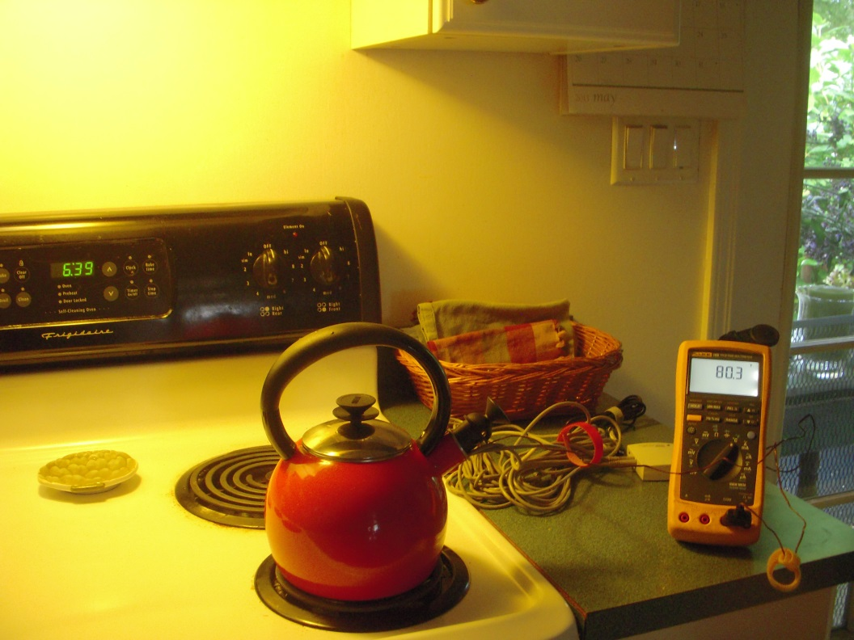
Phase Changes and Saturated Systems
An Experiment
Heat water in a low pressure boiler
Monitor:
  Water temperature
  Vapor temperature over the water surface
  Power
Plot the results

Slide 15
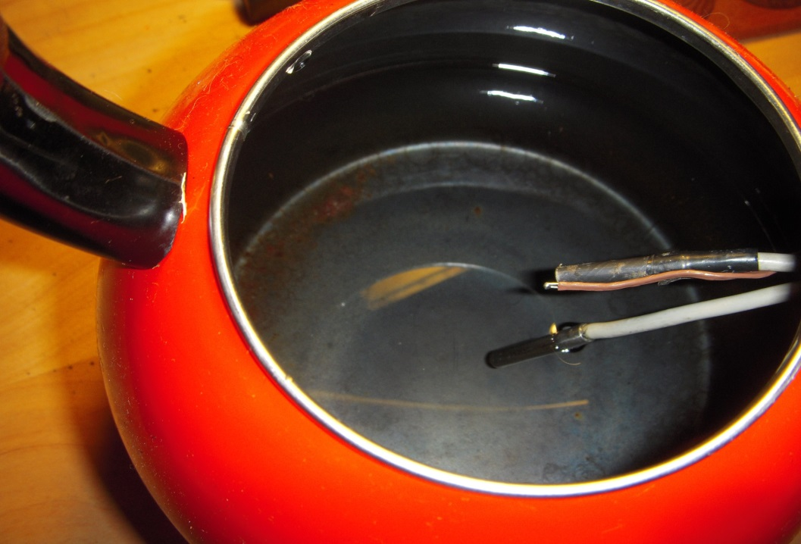
Phase Changes and Saturated Systems
An Experiment
Monitoring temperature
Vapor sensor
Thermocouple
Liquid sensor

Slide 16
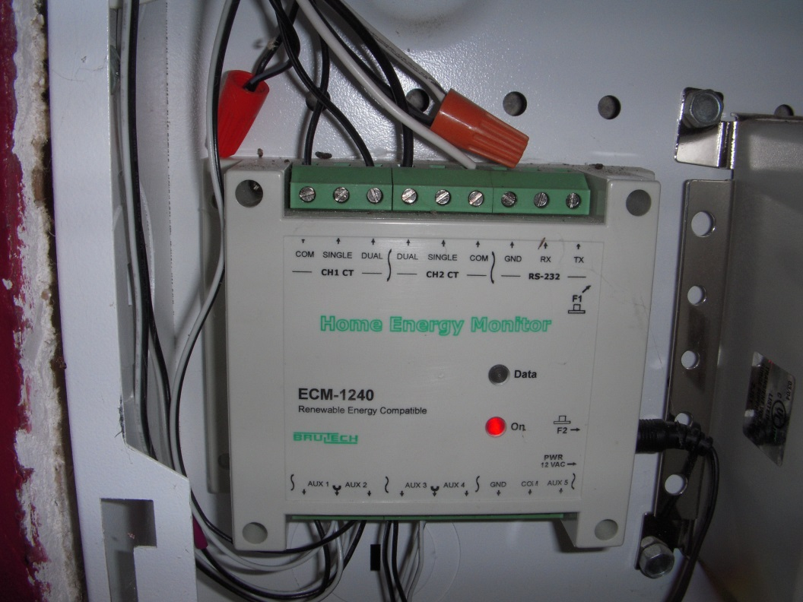
Phase Changes and Saturated Systems
An Experiment
Monitoring power

Slide 17
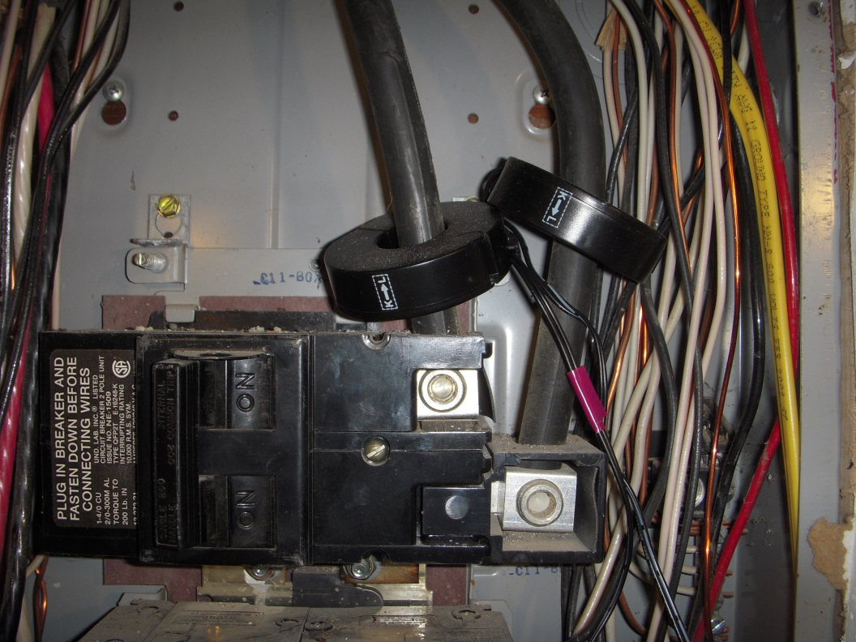
Phase Changes and Saturated Systems
An Experiment
Monitoring power

Slide 18
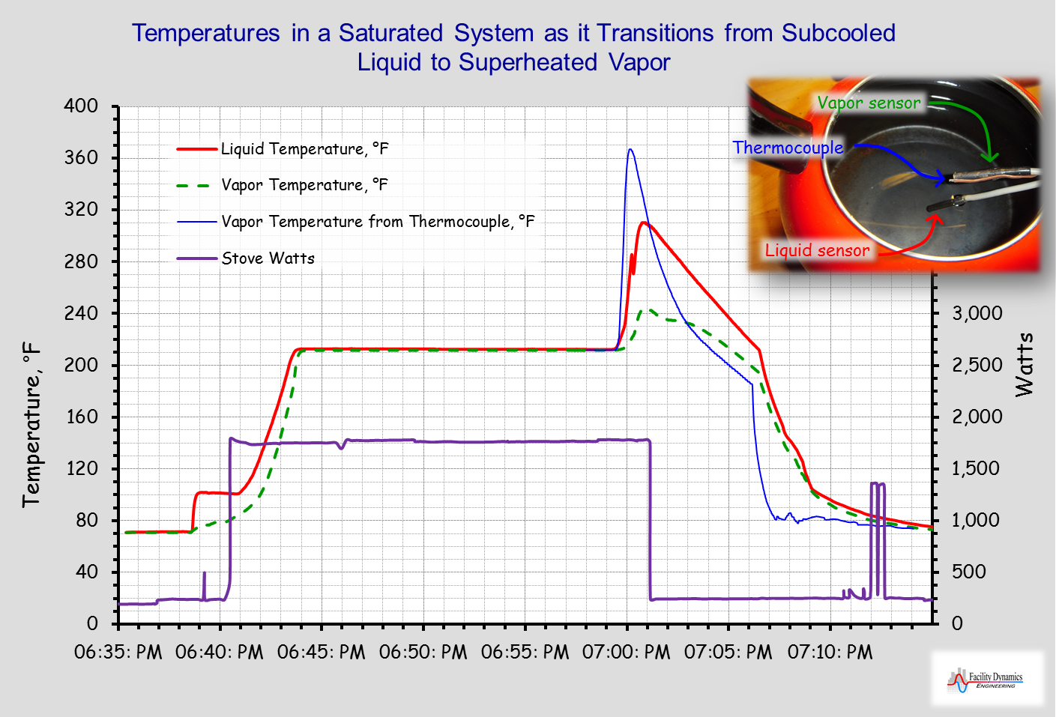

Slide 19
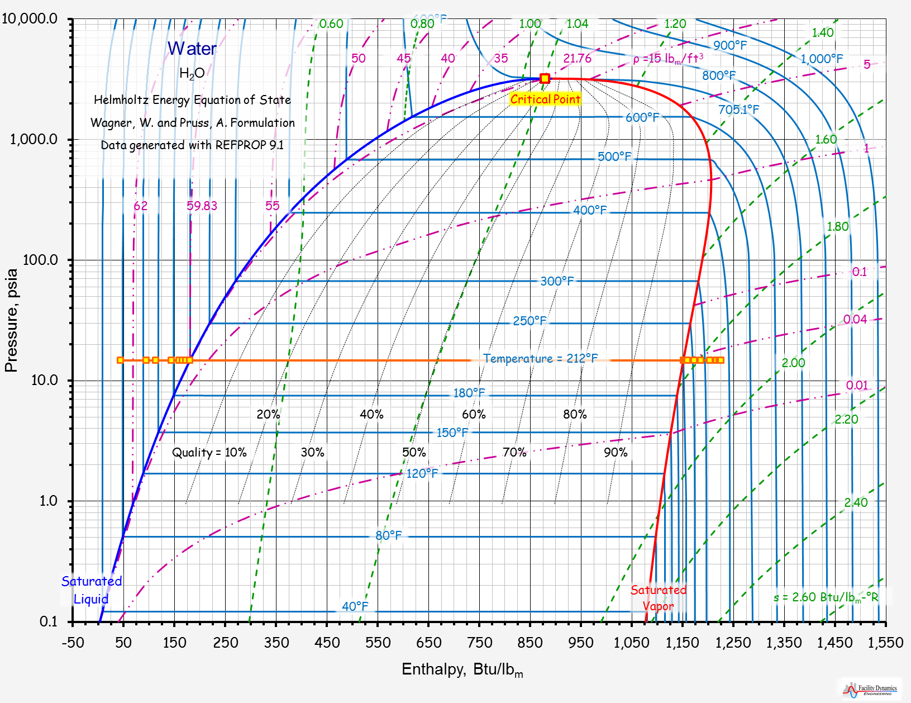

Slide 20
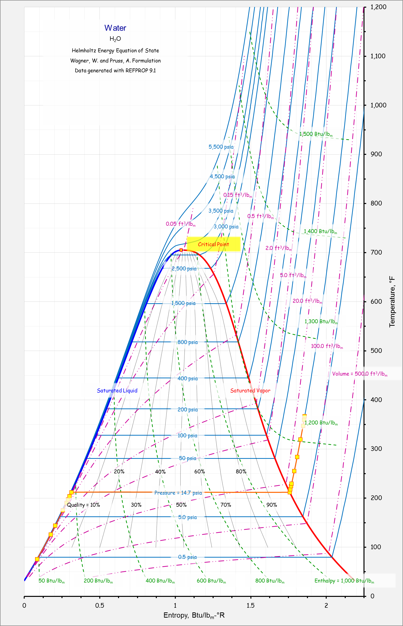

Slide 21
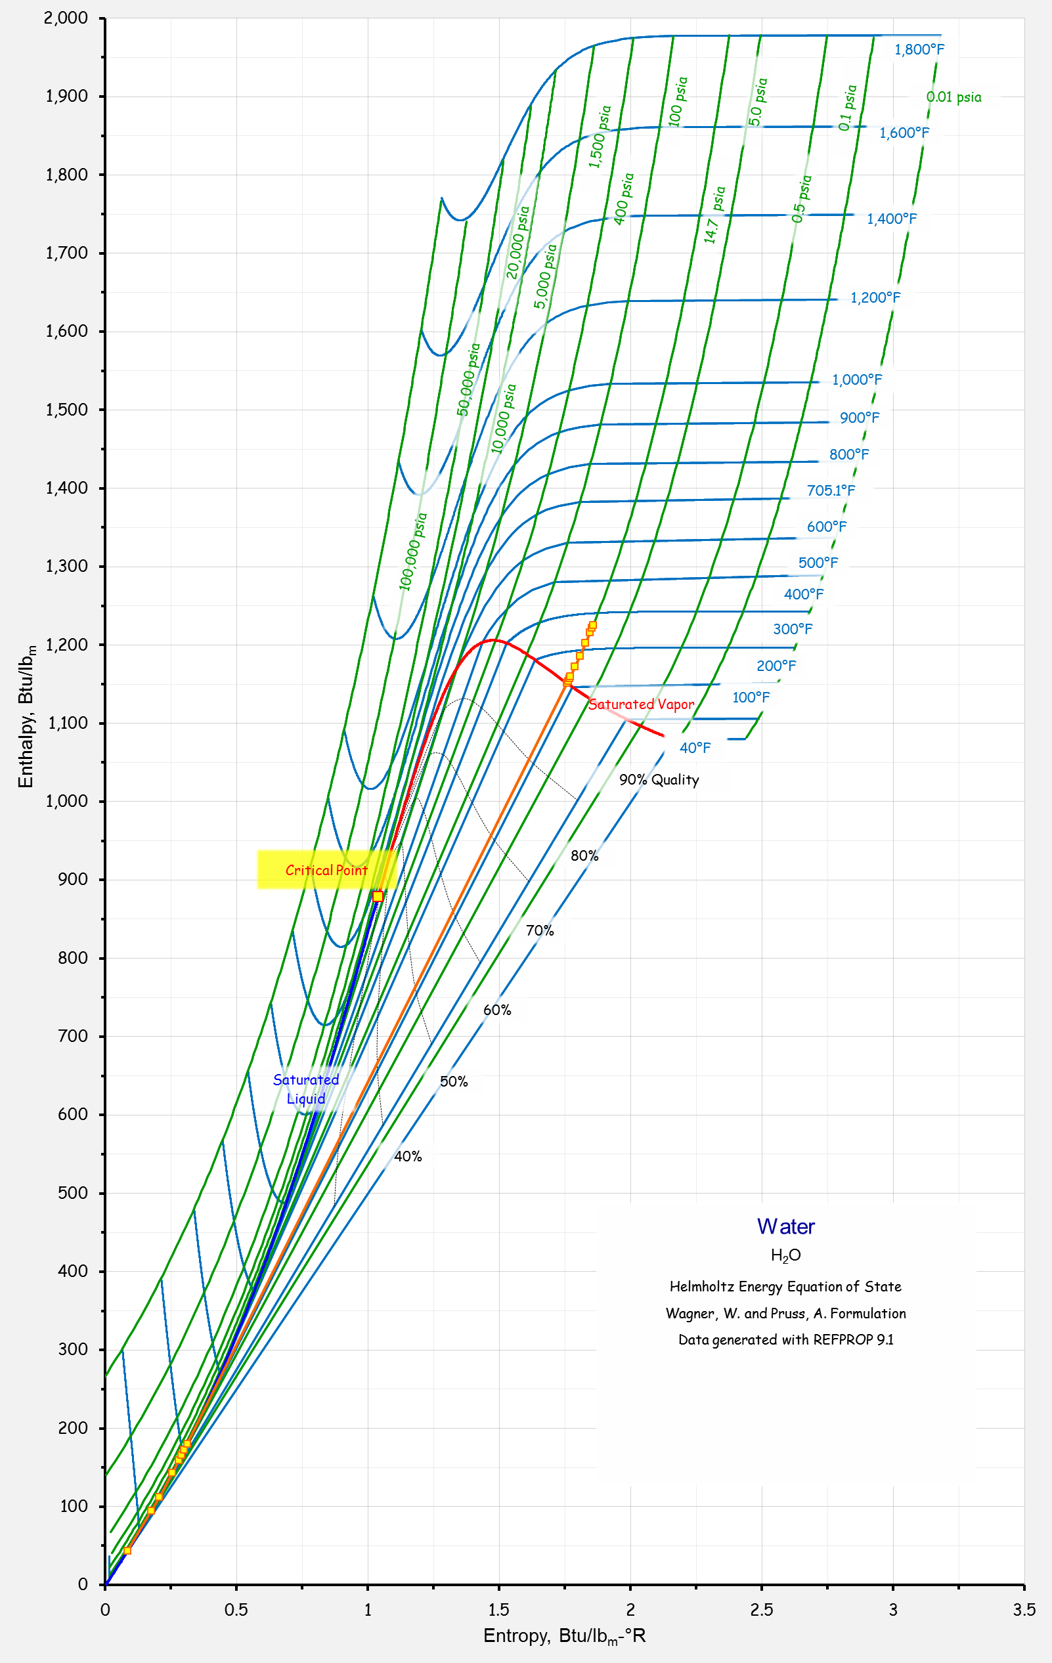

Slide 22
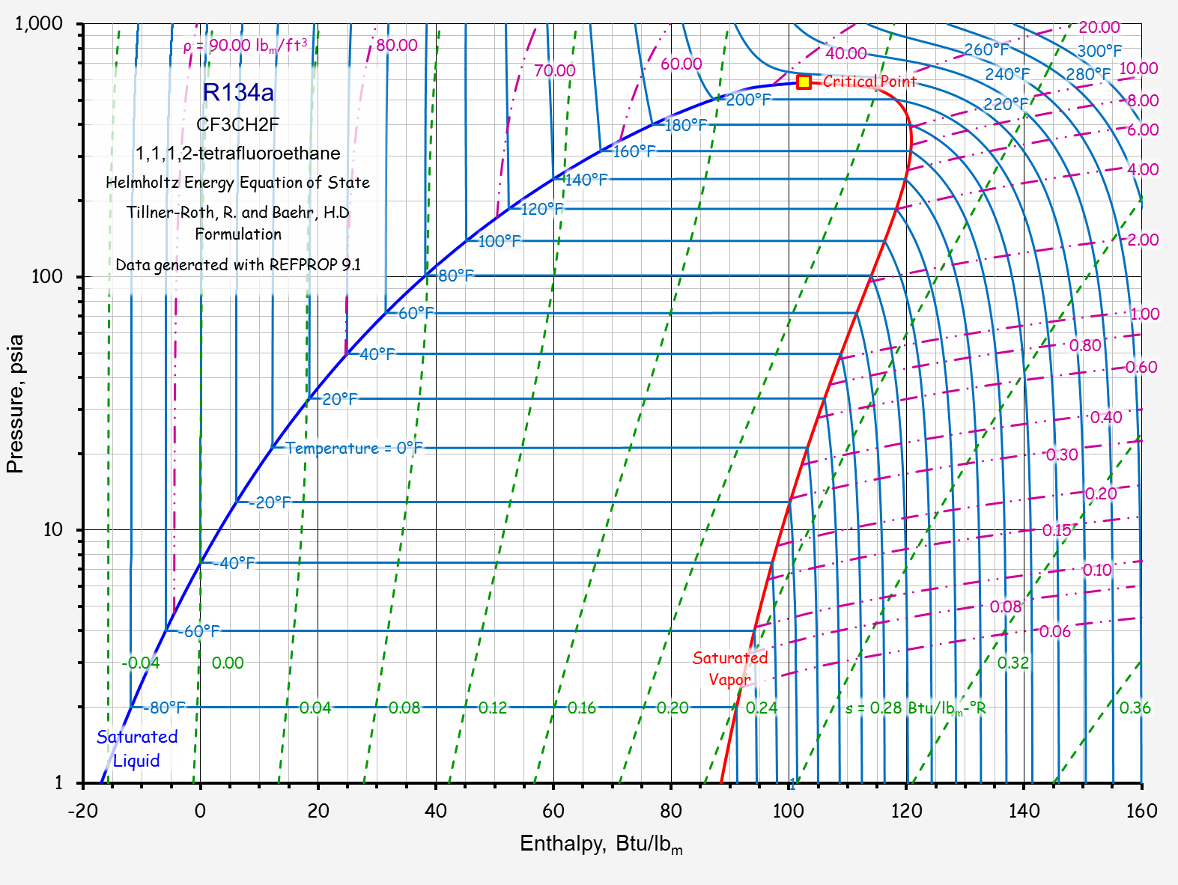

Slide 23
Vapor Compression Refrigeration Machines
An application of saturated system and phase change principles and concepts

Slide 24
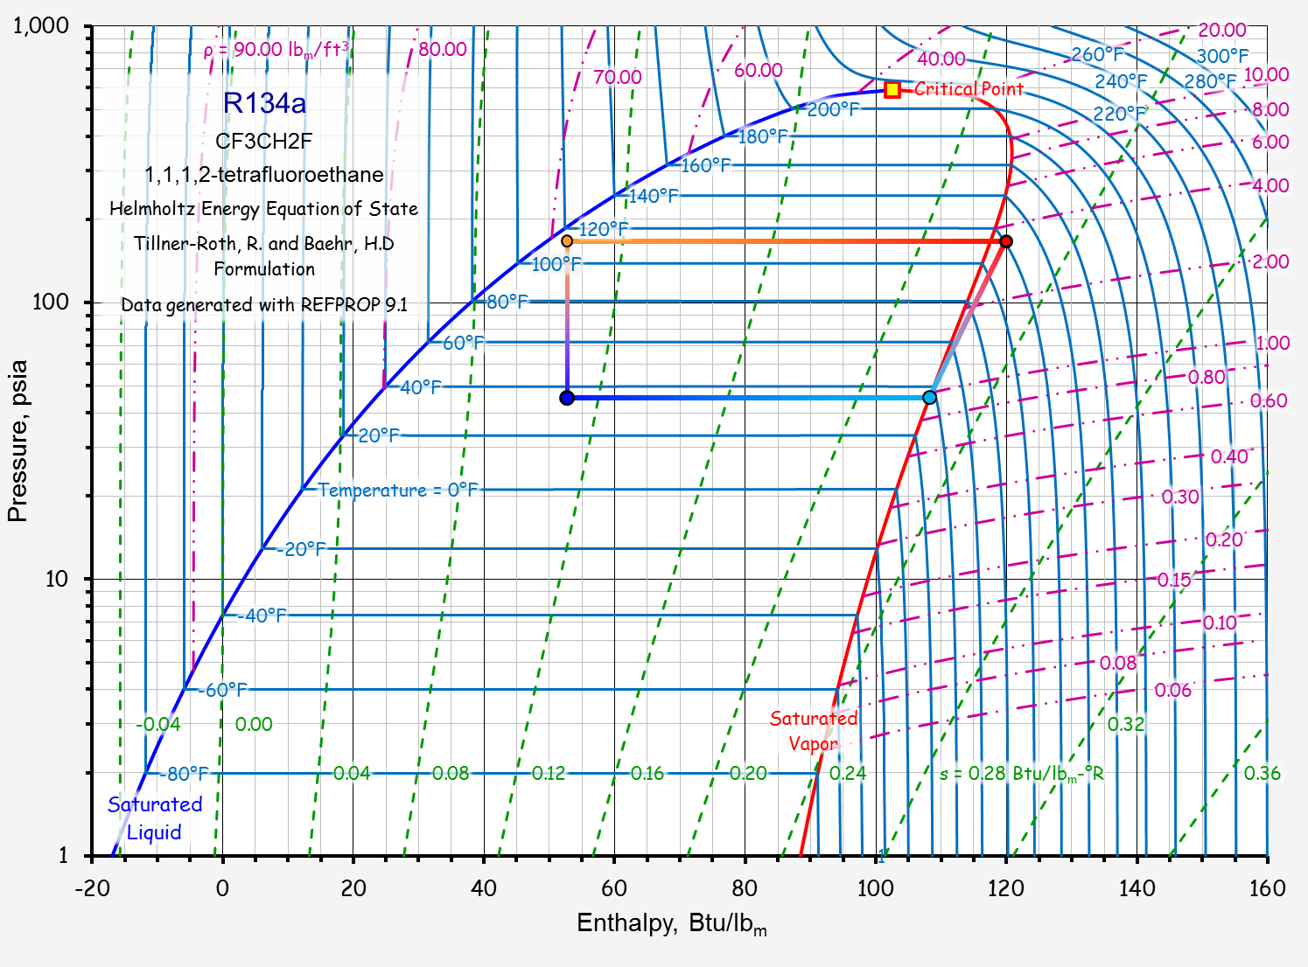
Condensation
Expansion
Compression
Evaporation

Slide 25
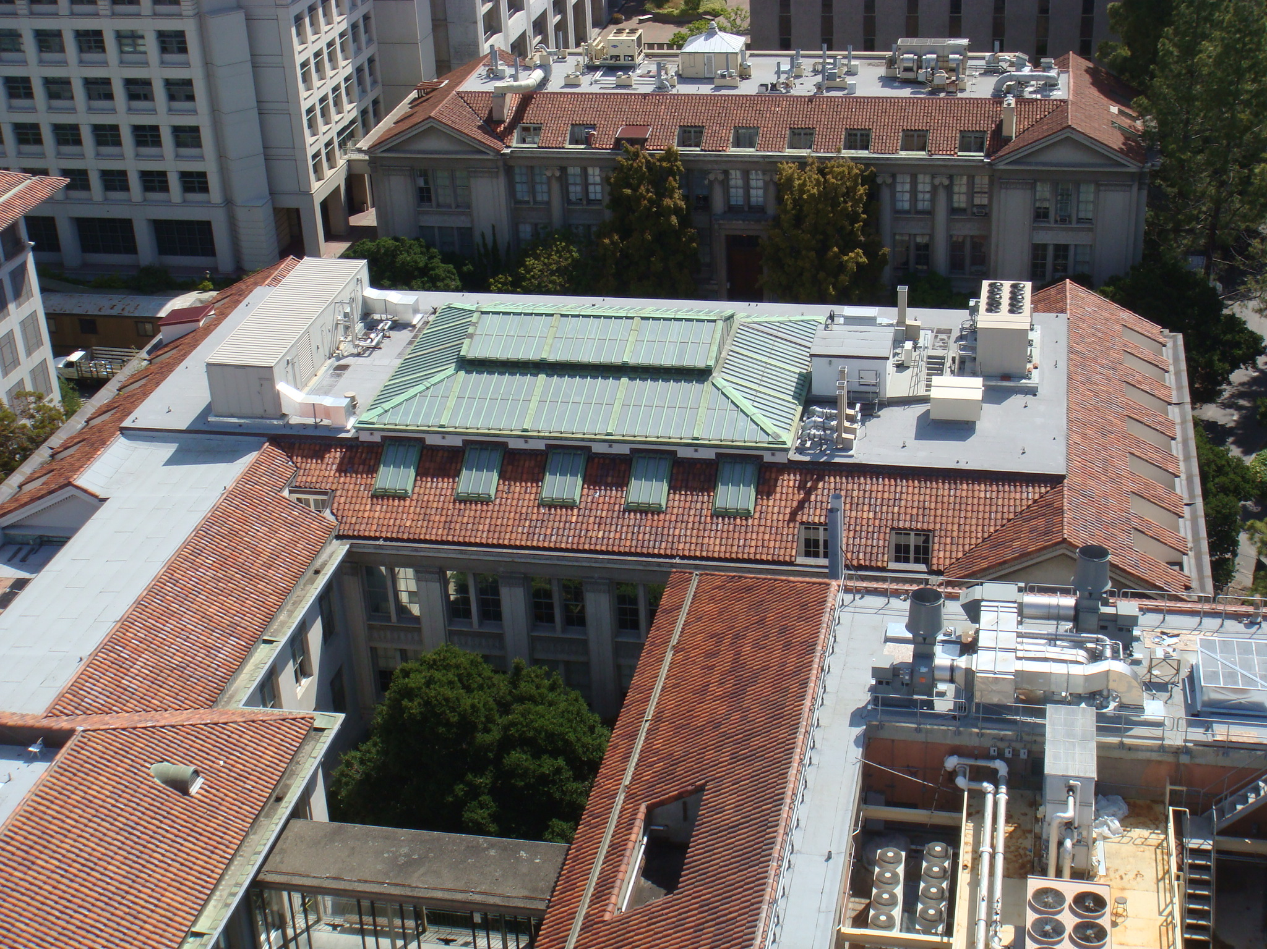
An Air Cooled Vapor Compression Cycle Chiller

Slide 26
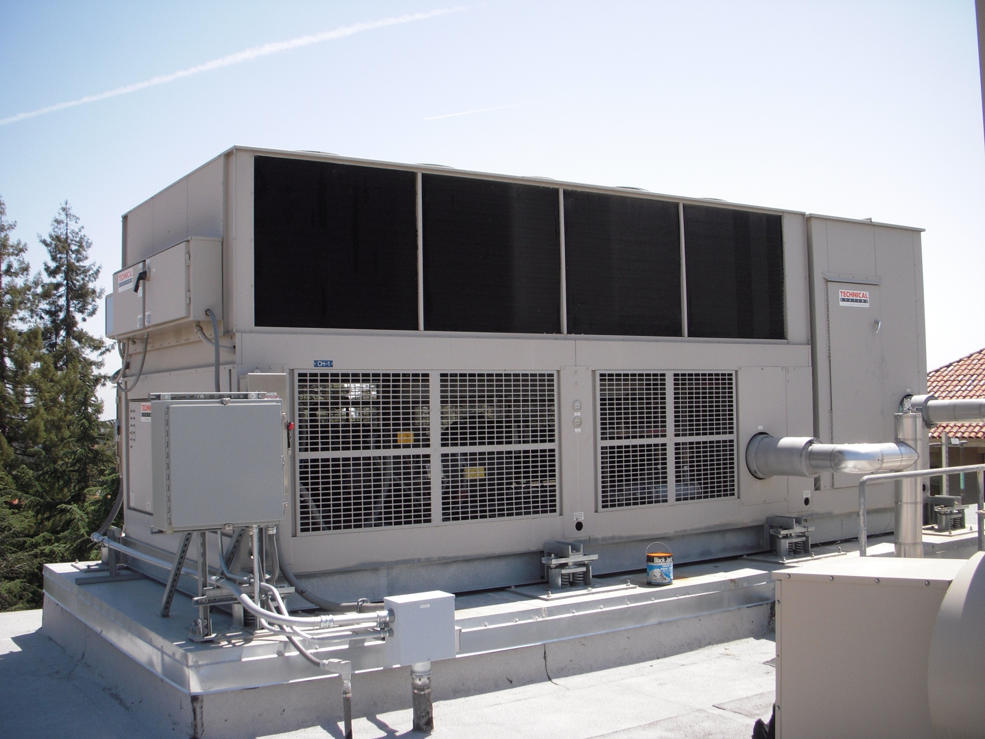

Slide 27
An Air Cooled Vapor Compression Cycle Chiller

Slide 28
Hot Gas Line
Liquid Line Solenoid Valve
Liquid Line
Suction Line
Evaporator

Slide 29
Which Pipe is Which
Suction Line
Liquid Line
Hot gas line
Largest, coldest and insulated
Smallest, warm, usually not insulated
Size between suction and liquid line size, hot, typically not insulated

Slide 30
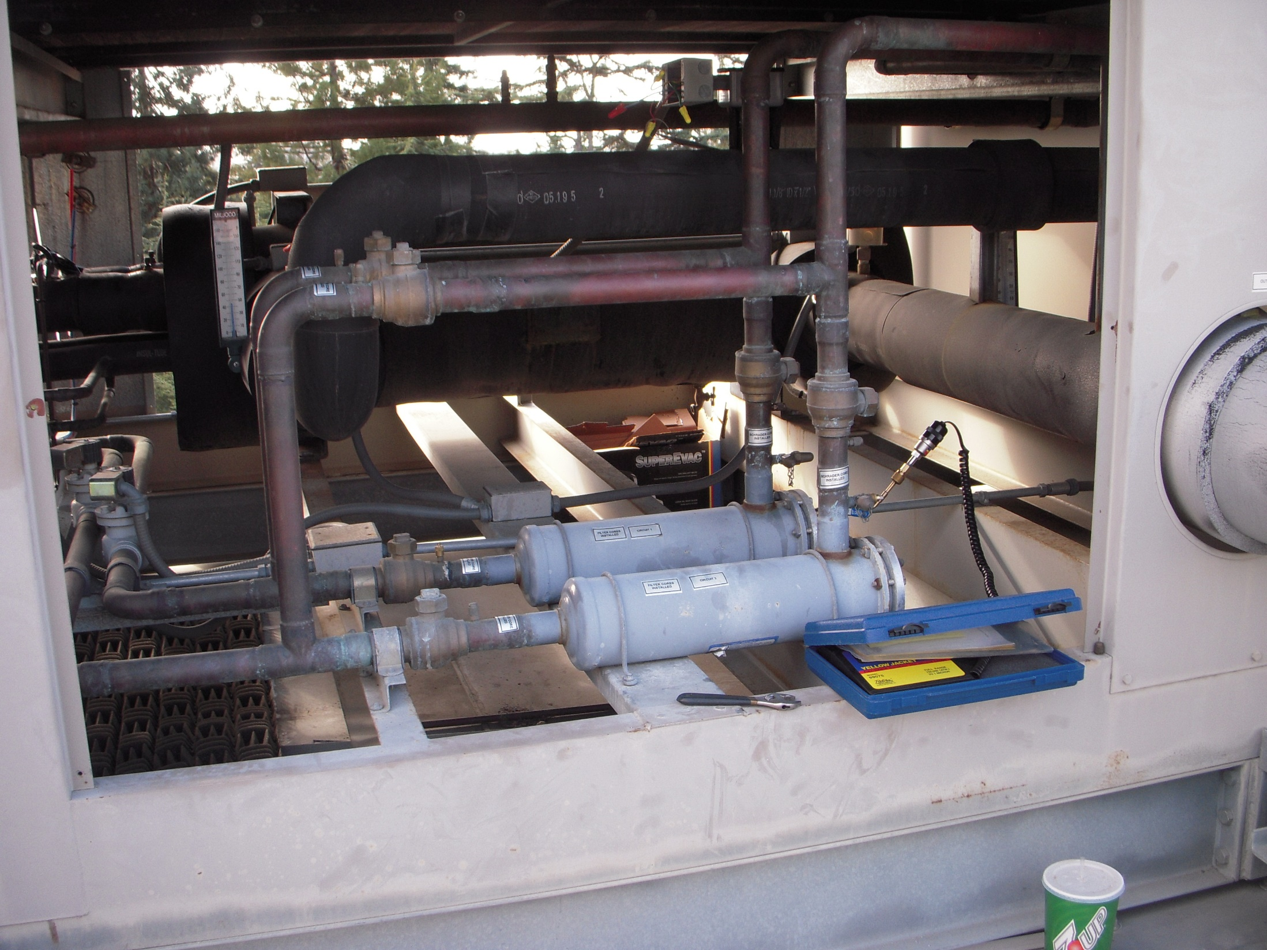
Service Bypass to Allow Filter Dryer to be Serviced (Not shown on diagram
Evaporator
Filter Dryer (Not shown on diagram)
Service Valves (Not shown on diagram

Slide 31
Liquid Lines
Chilled Water Pipes
Suction Line
Liquid Line Solenoid Valve

Slide 32
Hot Gas Line
Liquid Line
Suction Line
Evaporator
Compressor

Slide 33
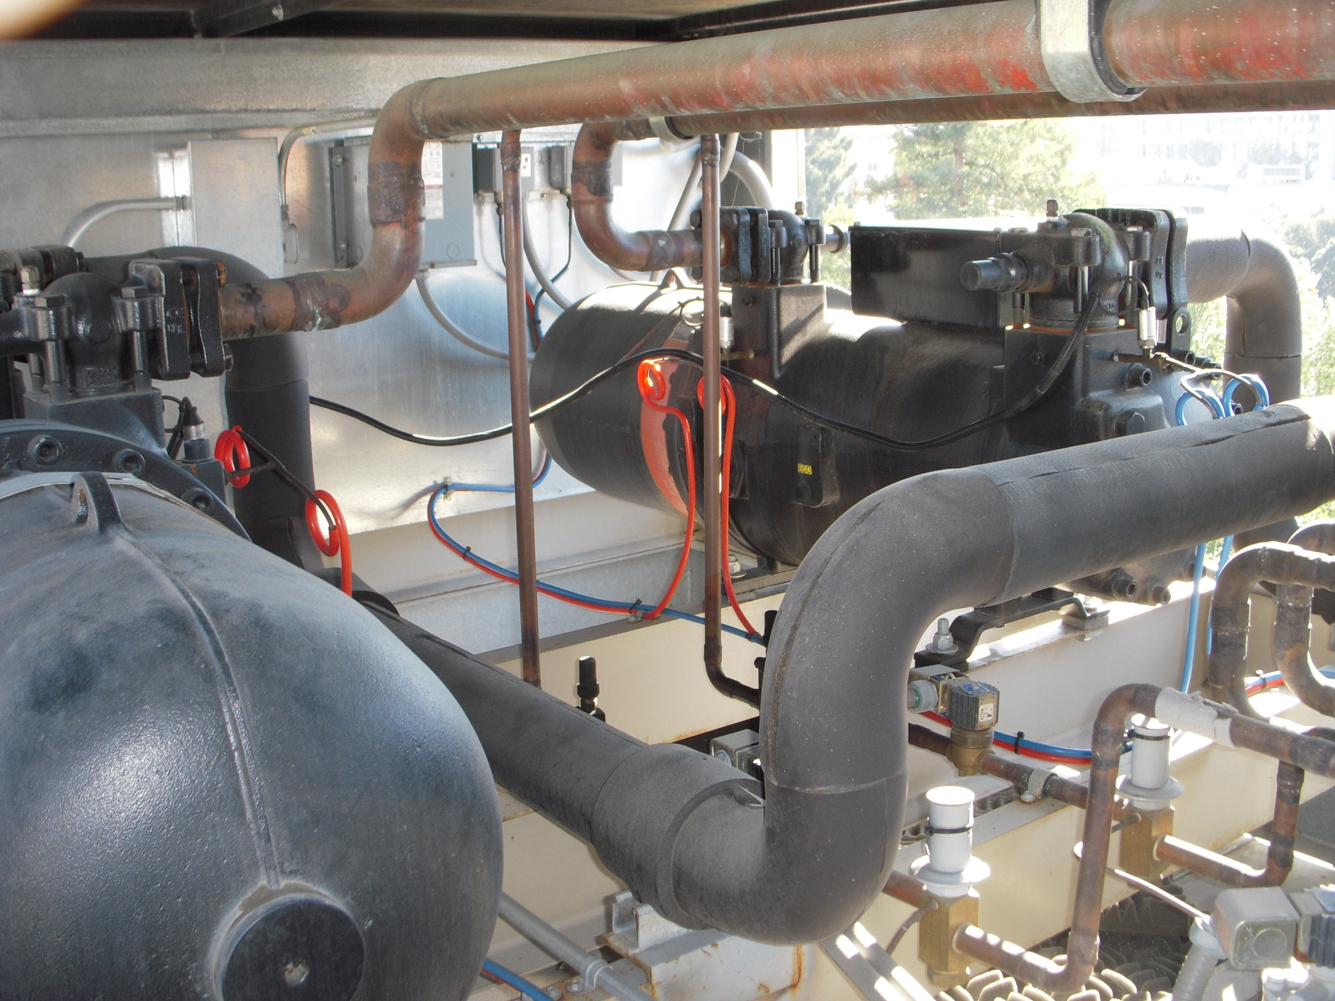
Hot Gas Lines
Compressor
Compressor
Suction Line

Slide 34
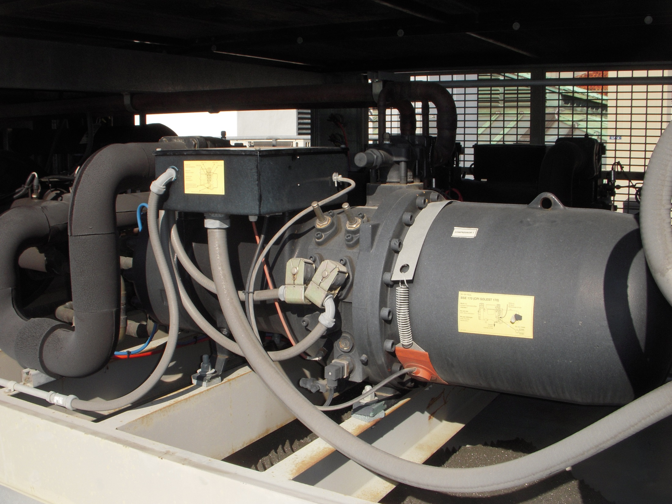
Compressor
Suction Line

Slide 35
Unloaders

Slide 36
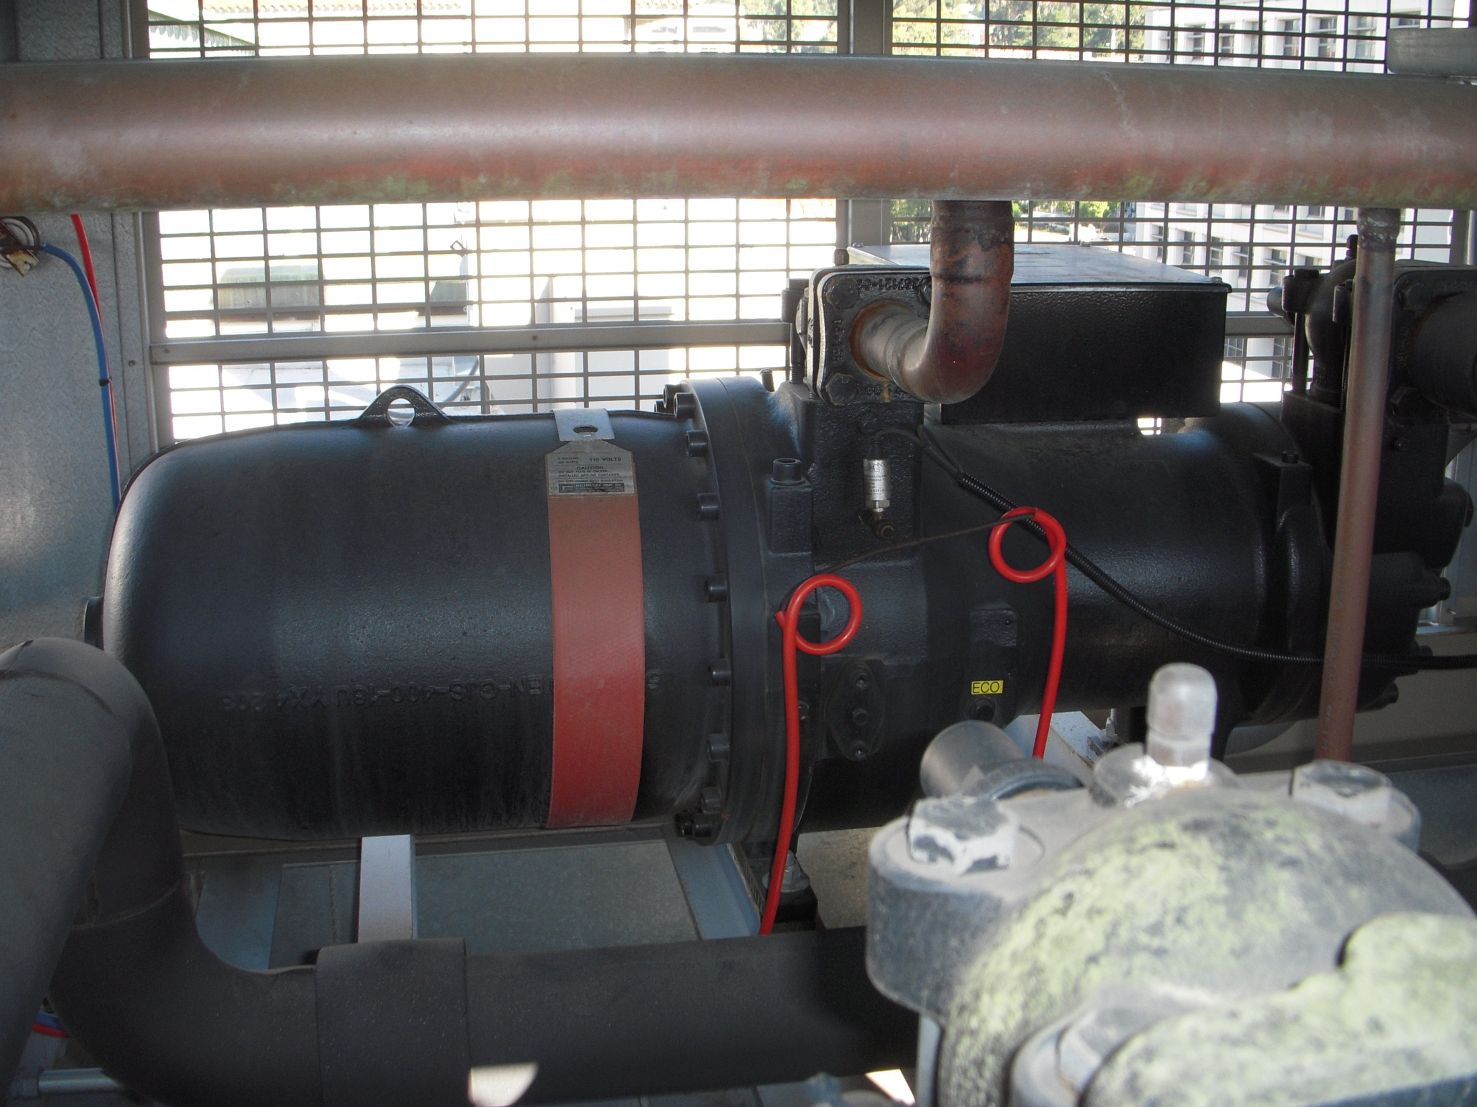
Crank Case Heater

Slide 37
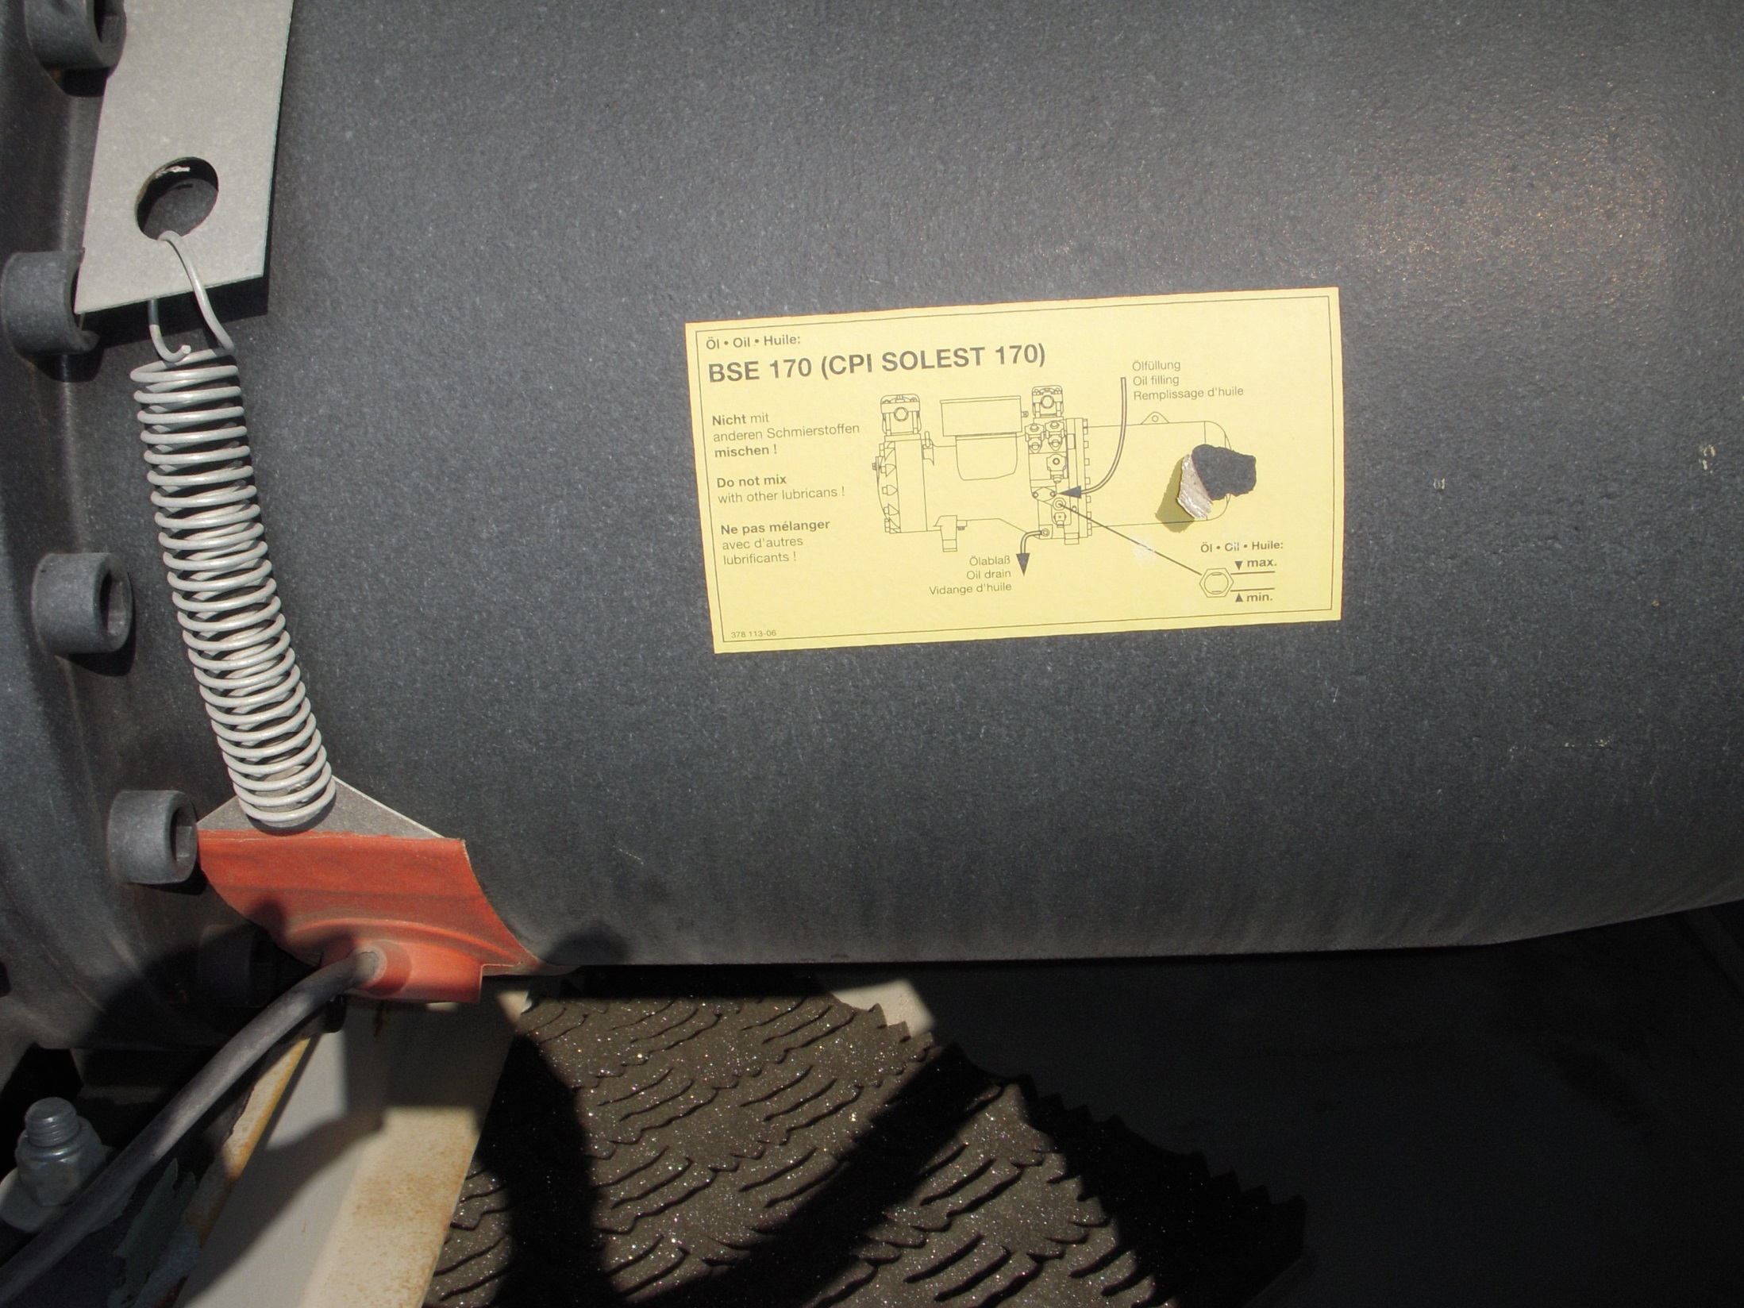
Crank Case Heater

Slide 38
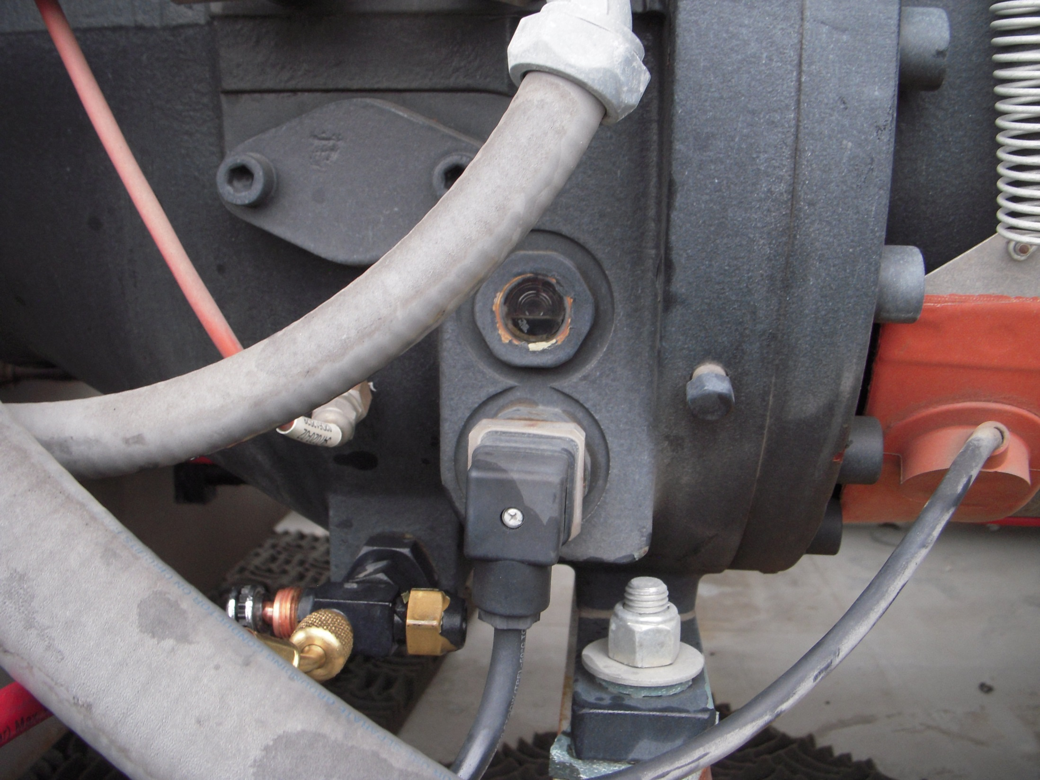
Oil Sight Glass

Slide 39
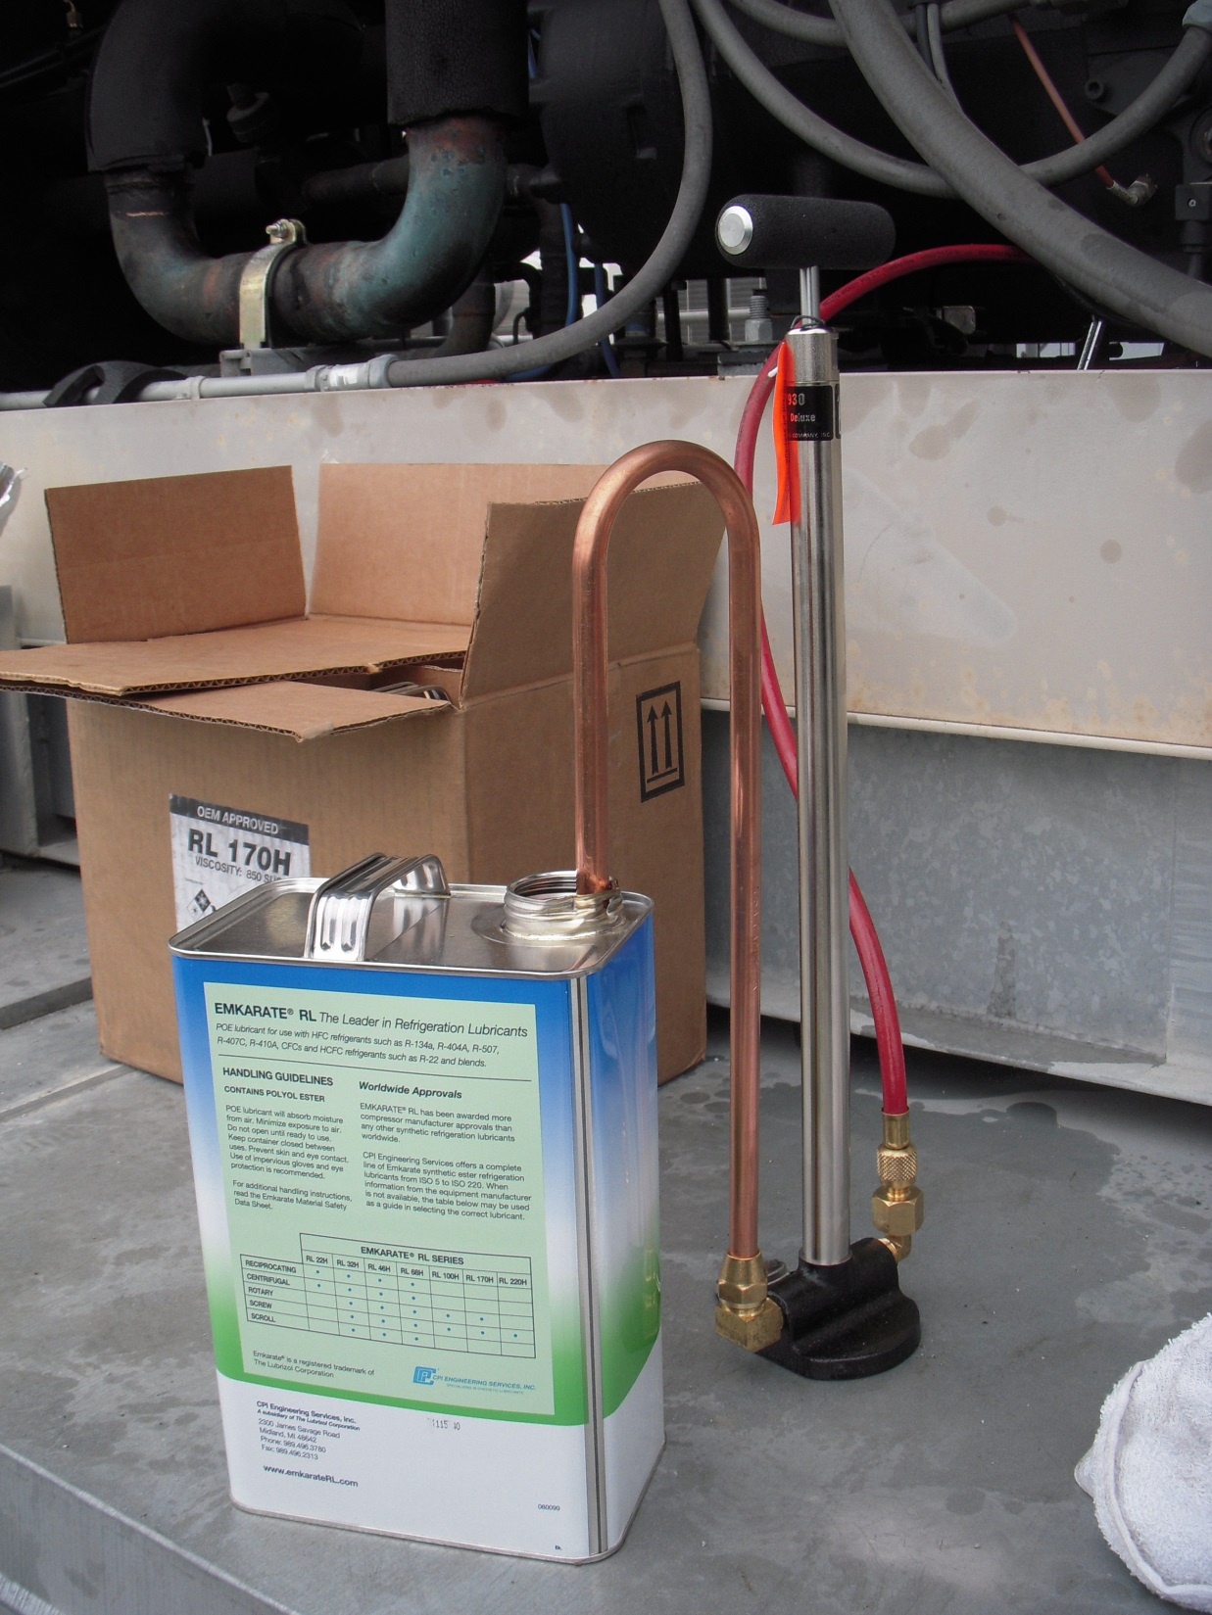
Hand Pump for Adding Oil

Slide 40
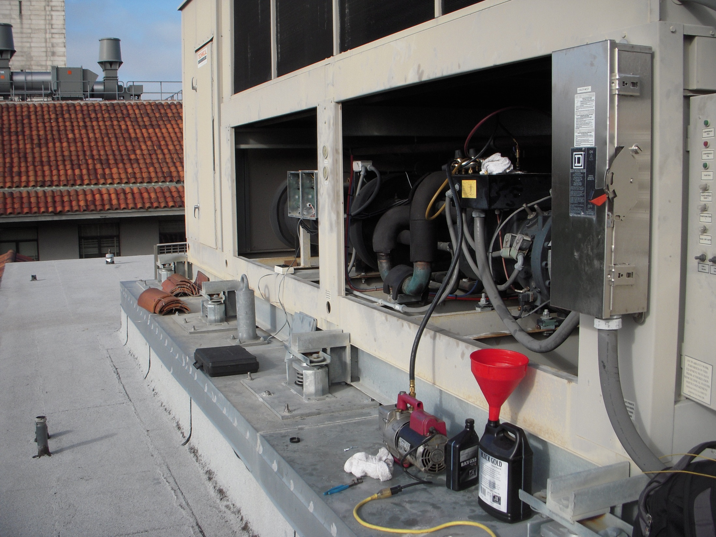
Vacuum Pump Evacuating the System in Preparation for Charging
Vacuum Pump

Slide 41
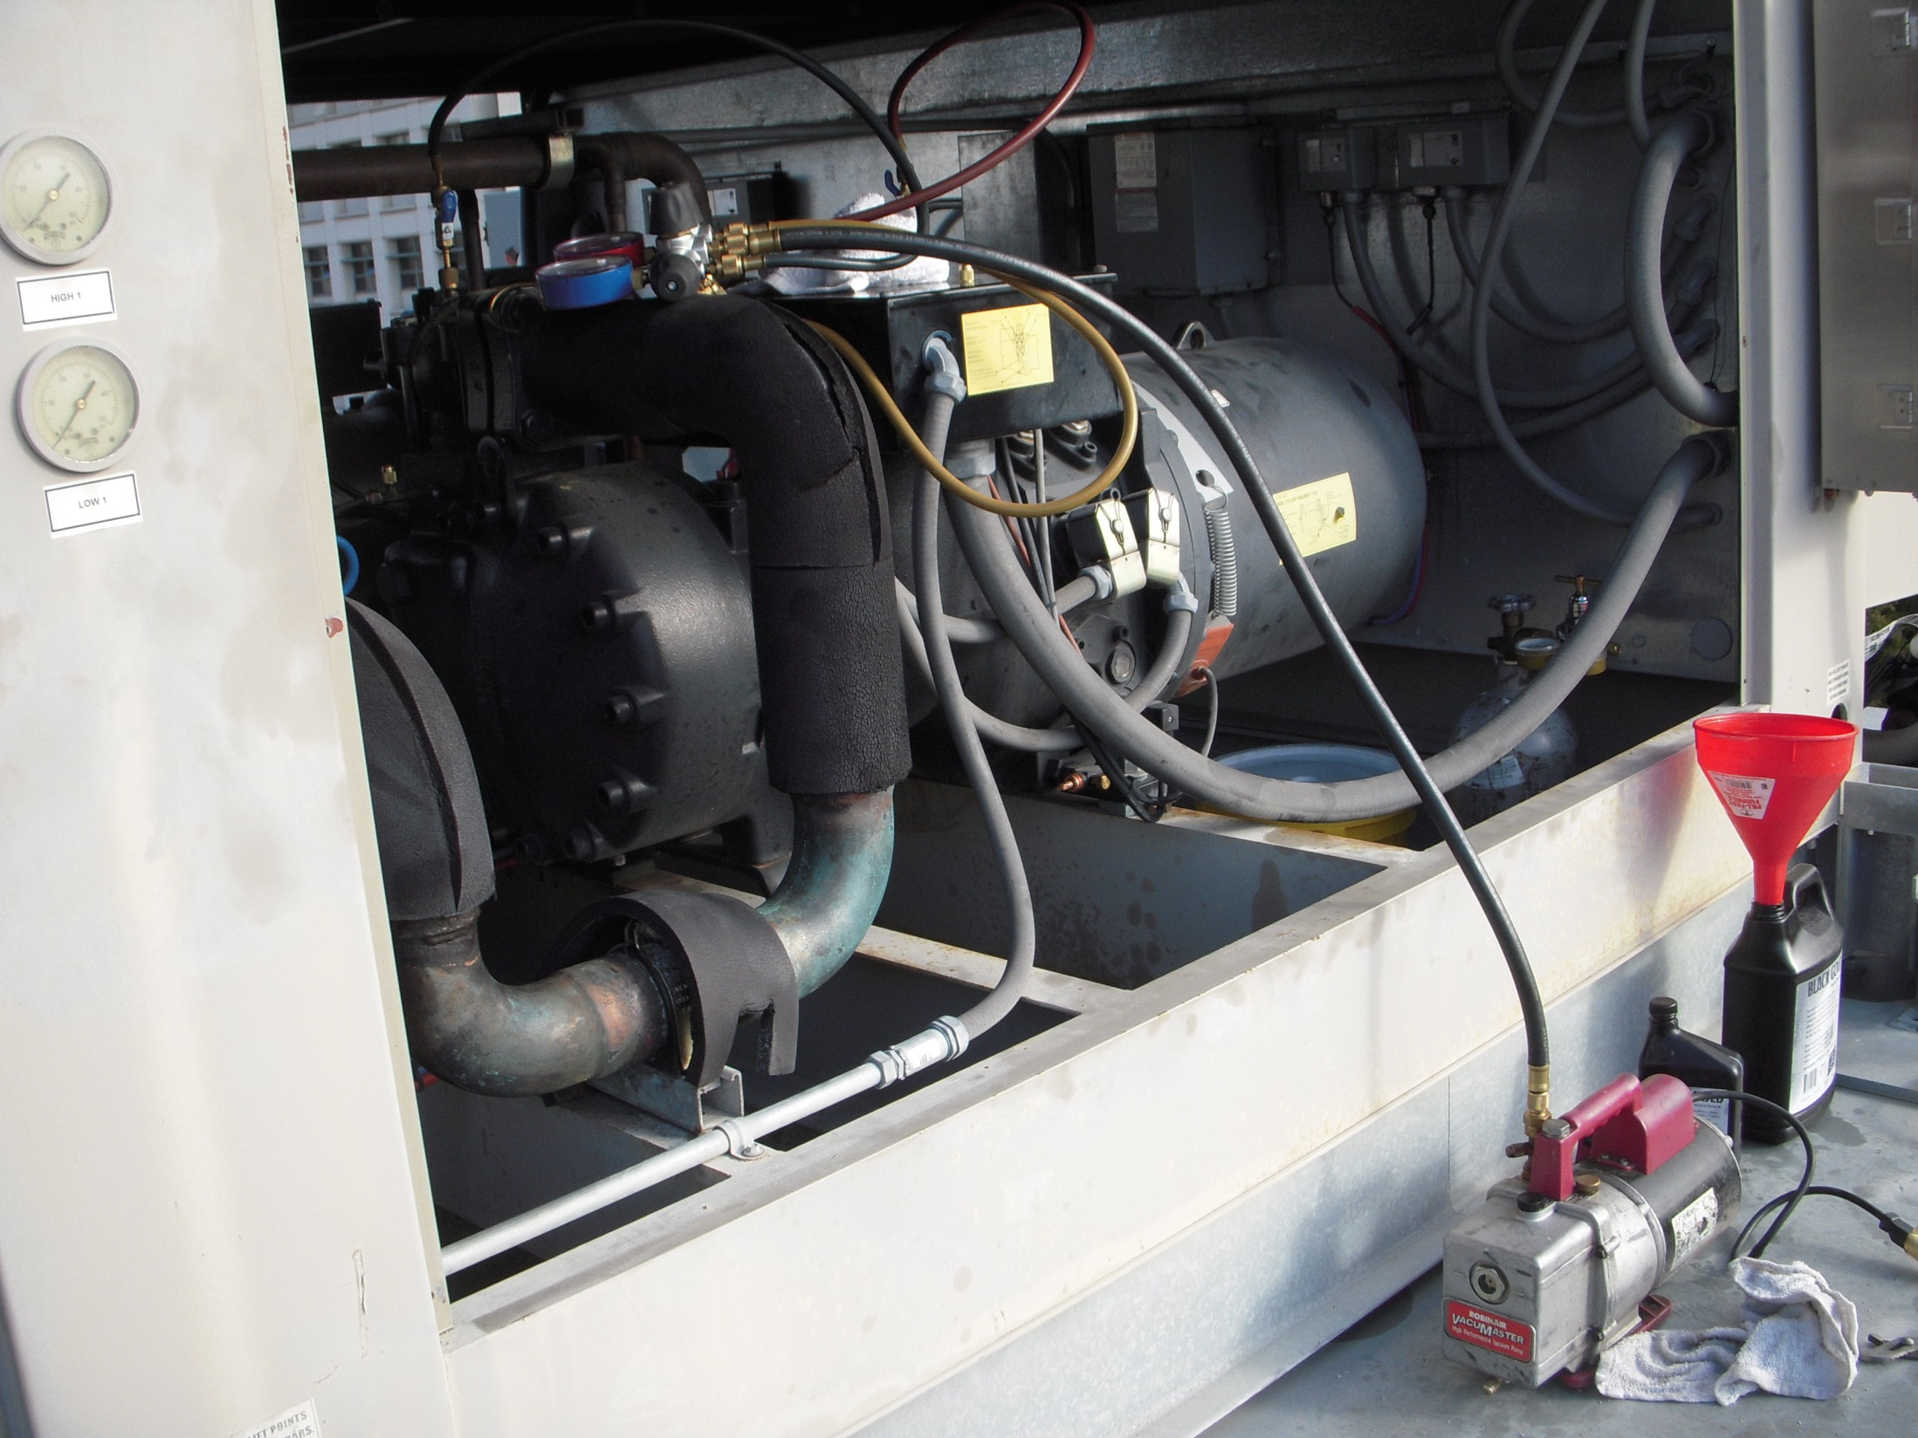

Slide 42
Condenser
Receiver
Compressor

Slide 43
Condenser

Slide 44
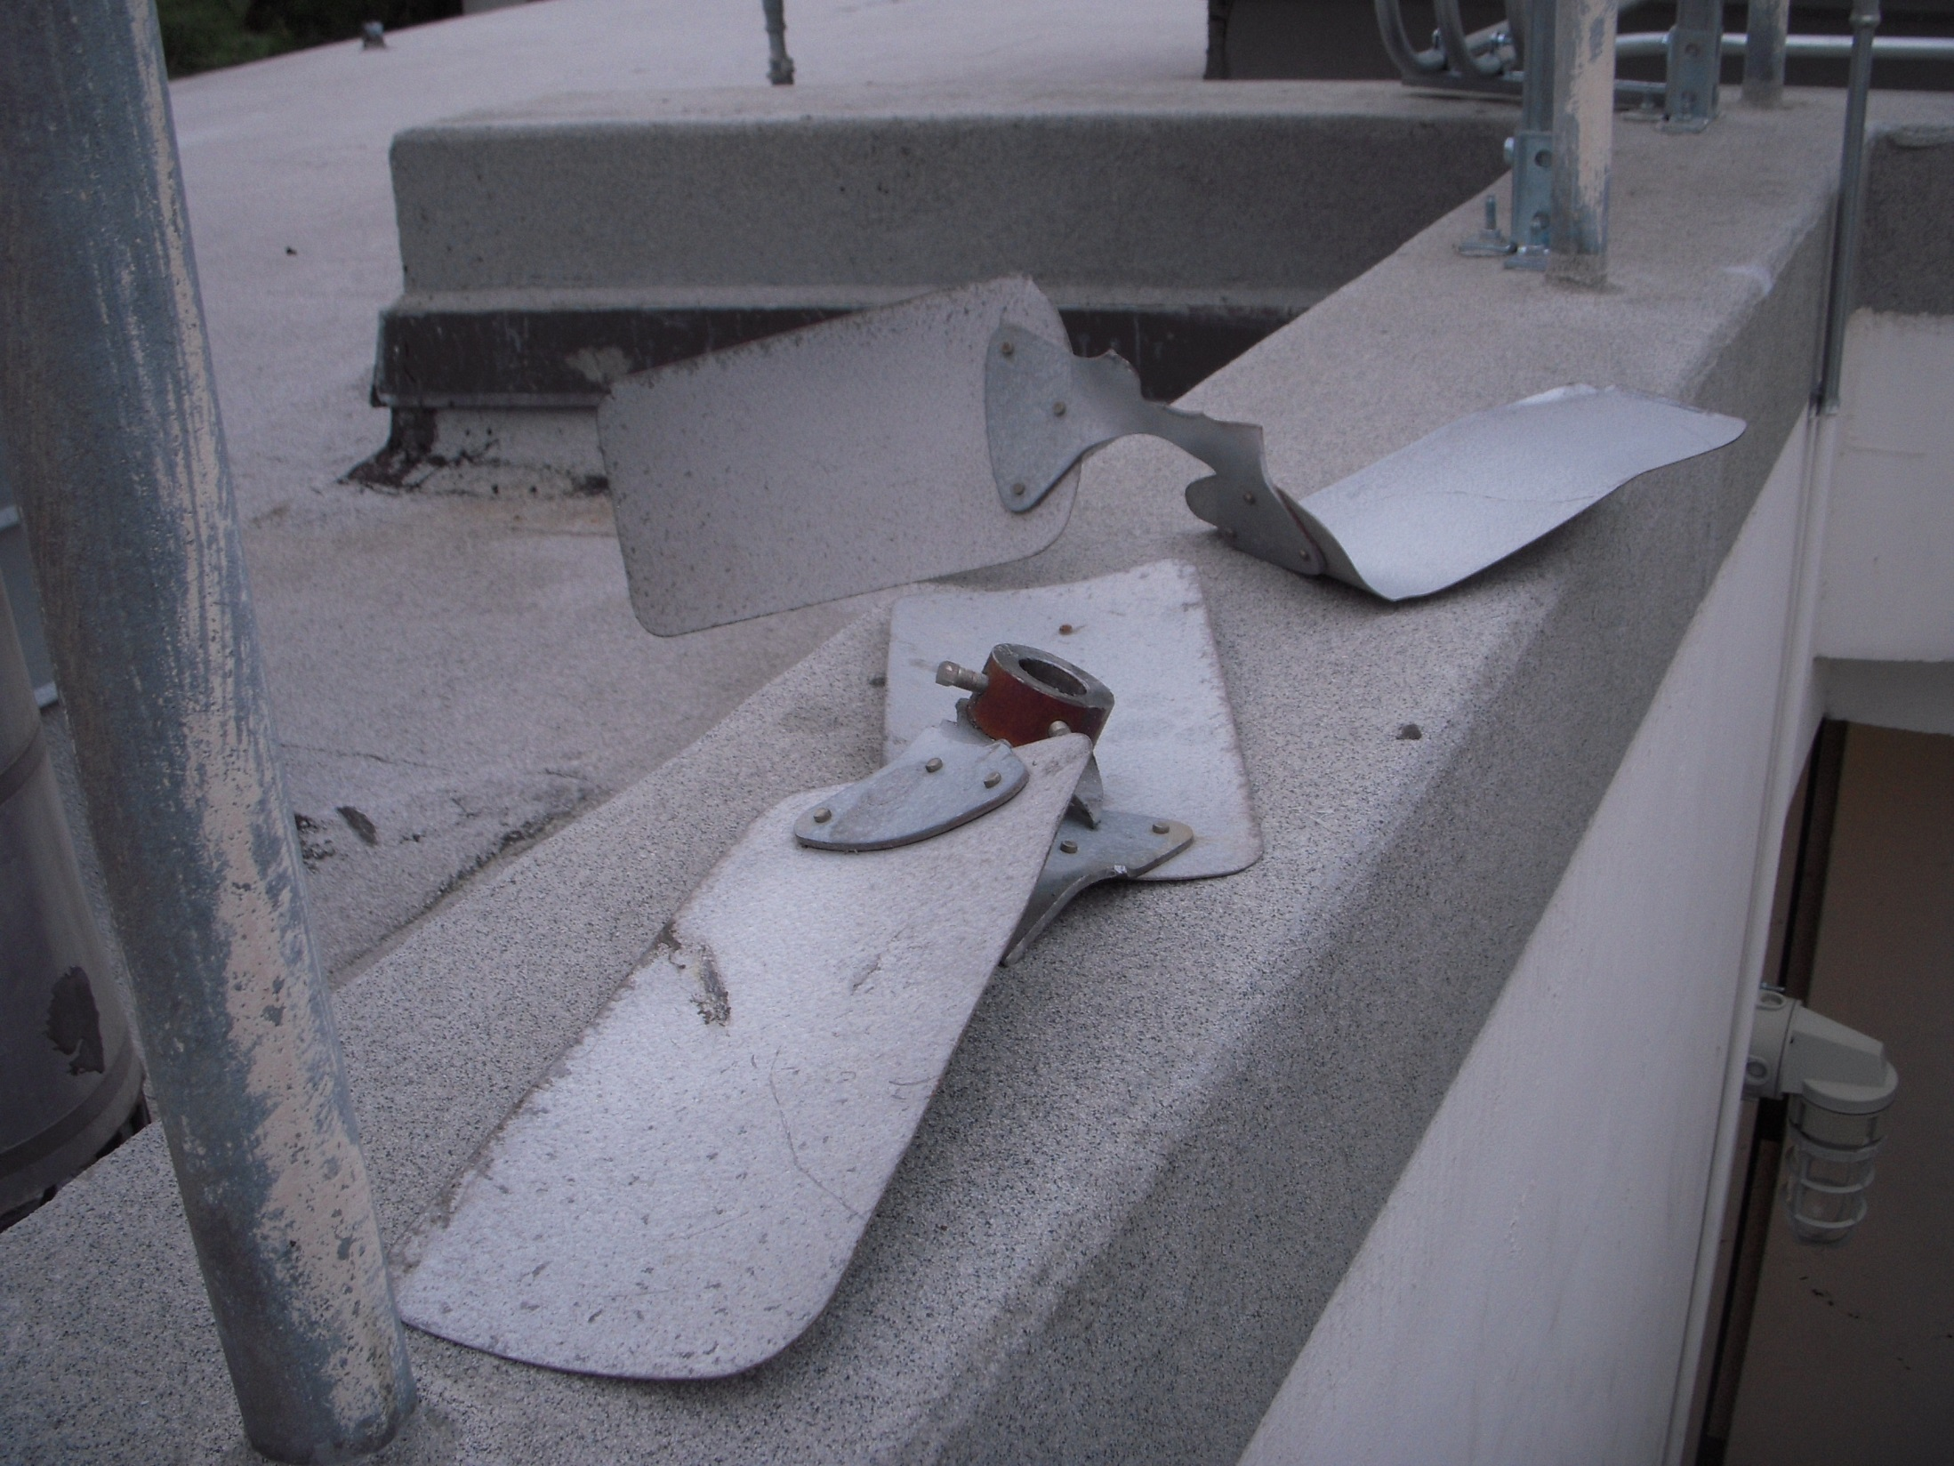
Failed Condenser Fan

Slide 45
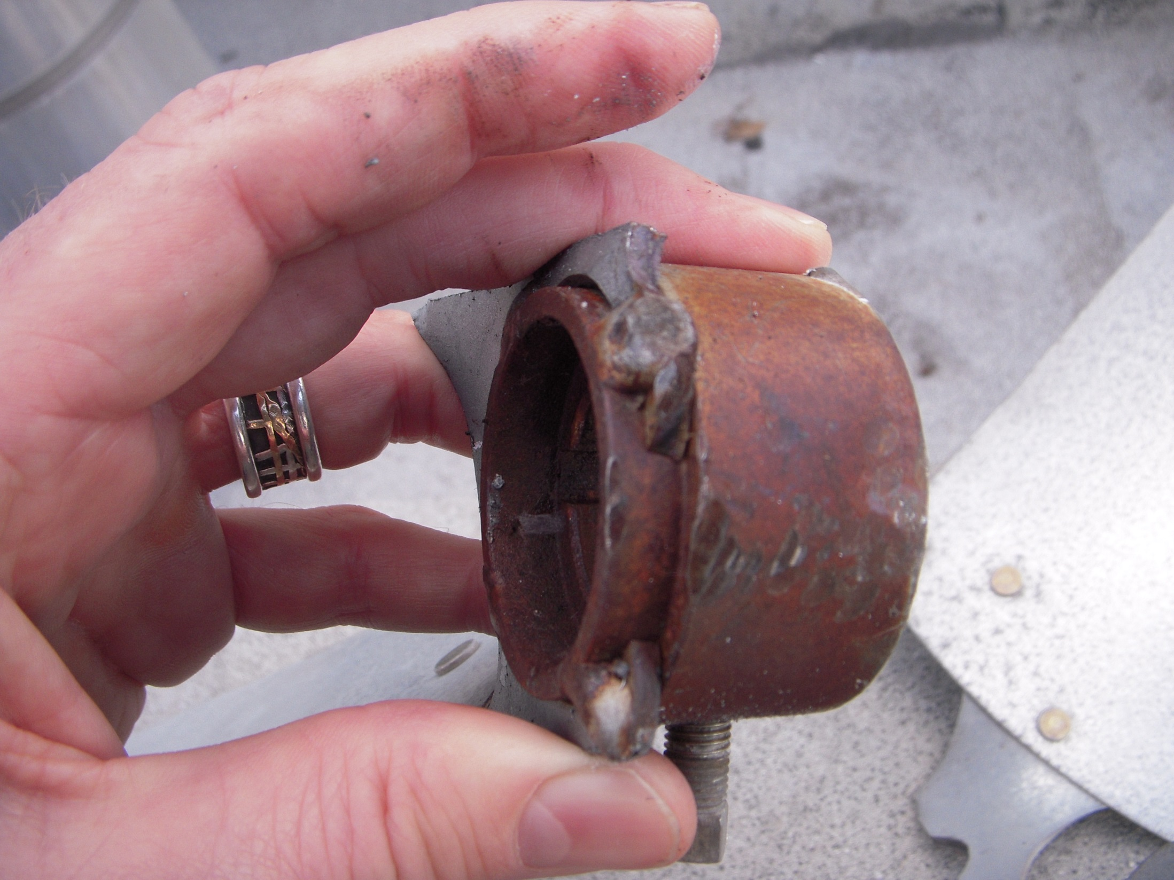

Slide 46
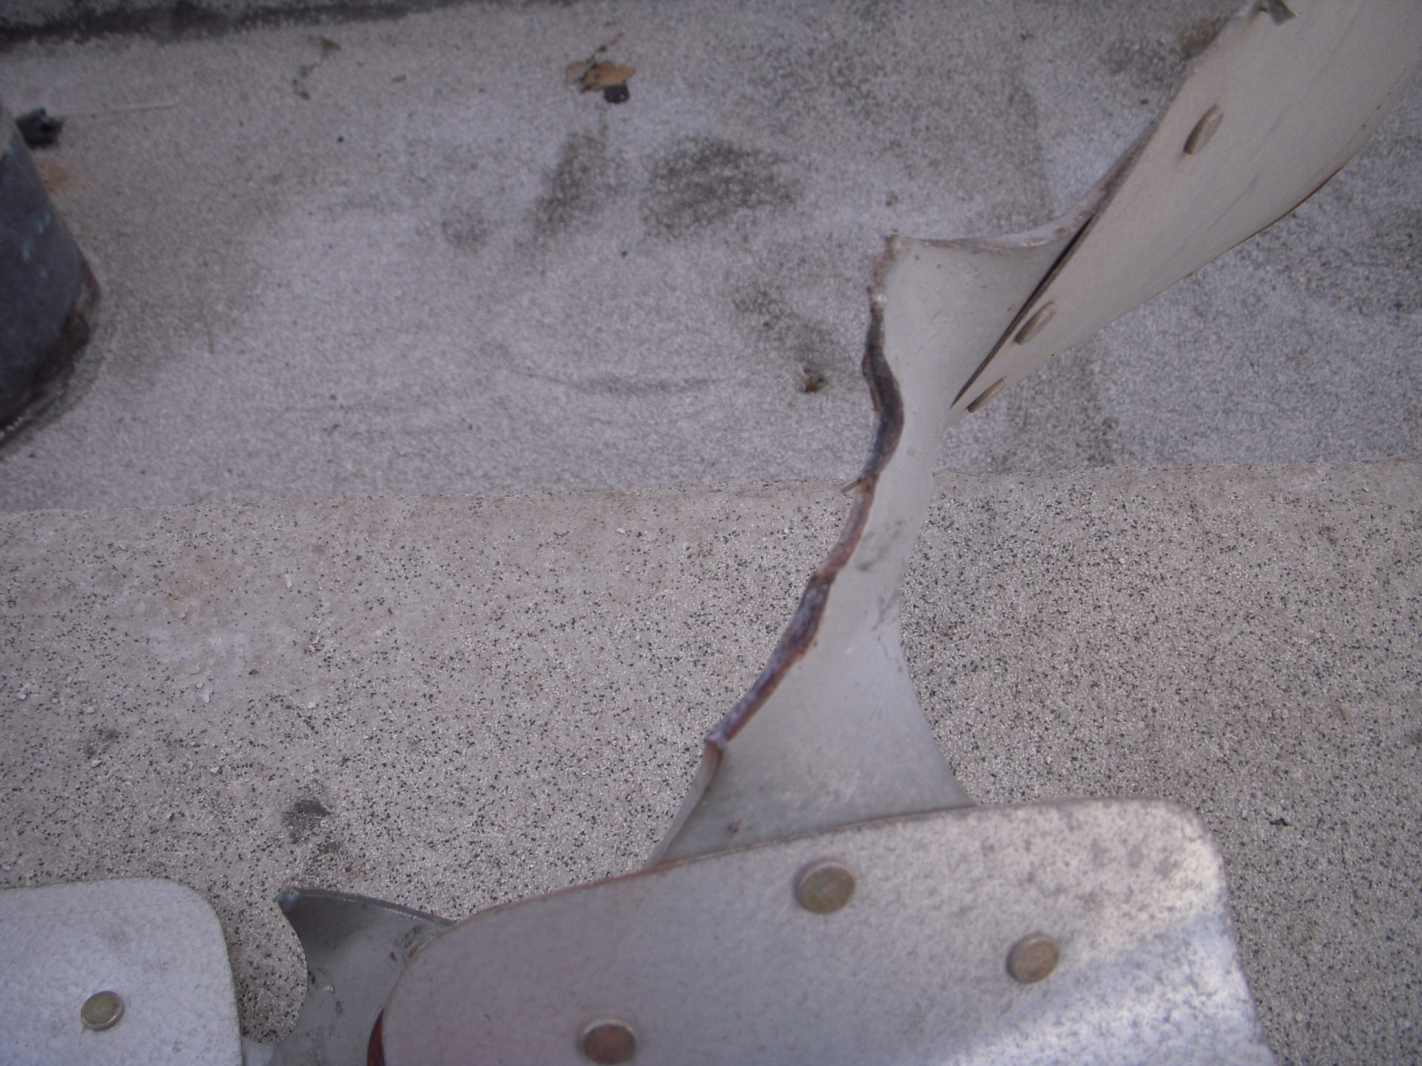

Slide 47
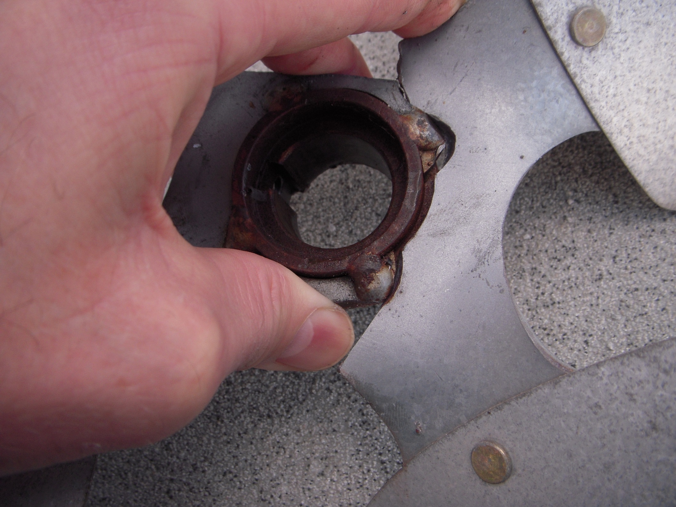

Slide 48
Condenser
Receiver
Liquid Line Solenoid Valve
Expansion Valve
Evaporator
Compressor

Slide 49
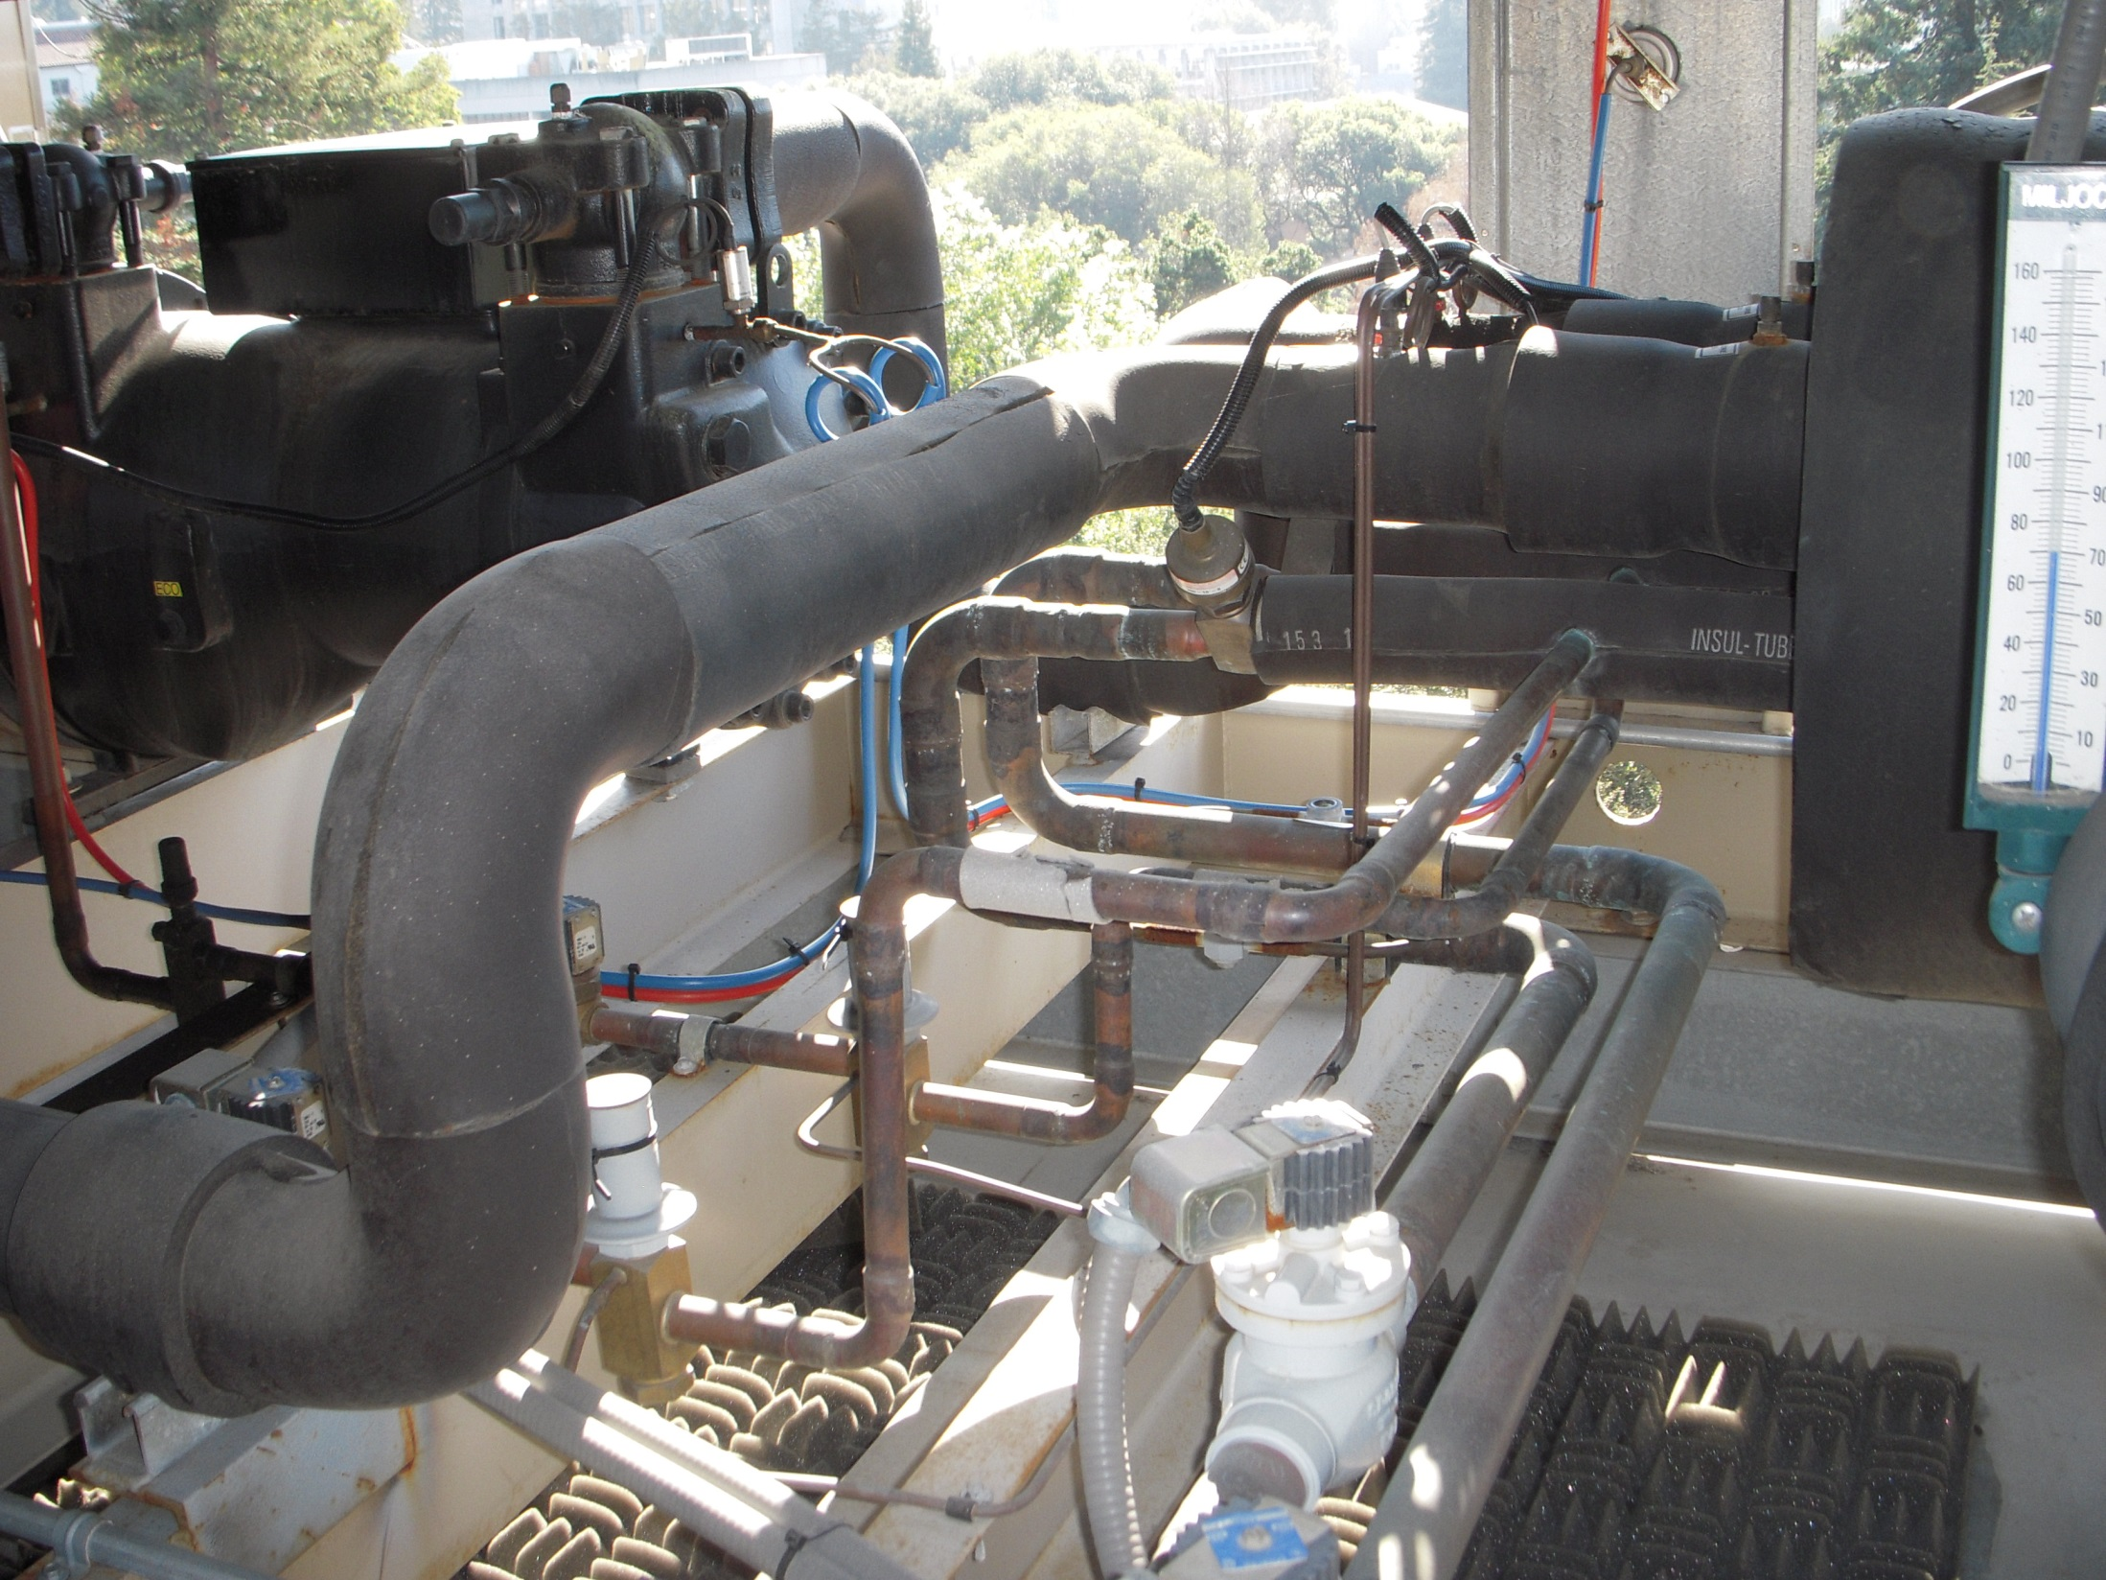
Expansion Valve
Suction Line
Liquid Line Solenoid Valve
Liquid Lines

Slide 50
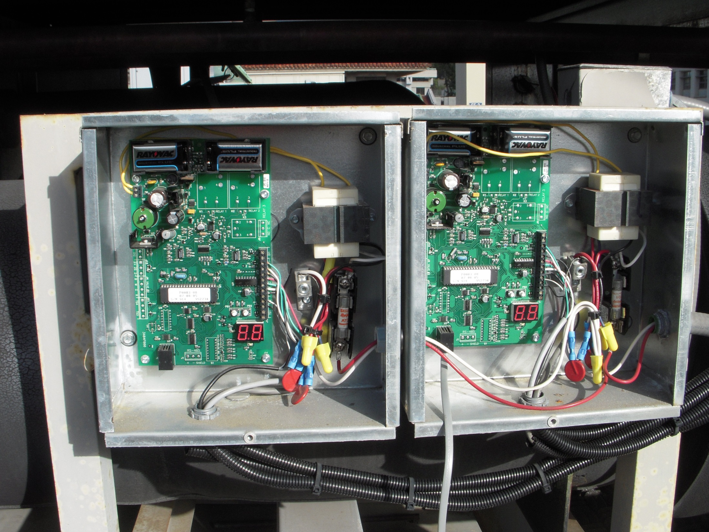
Electronic Expansion Valve Controllers

Slide 51
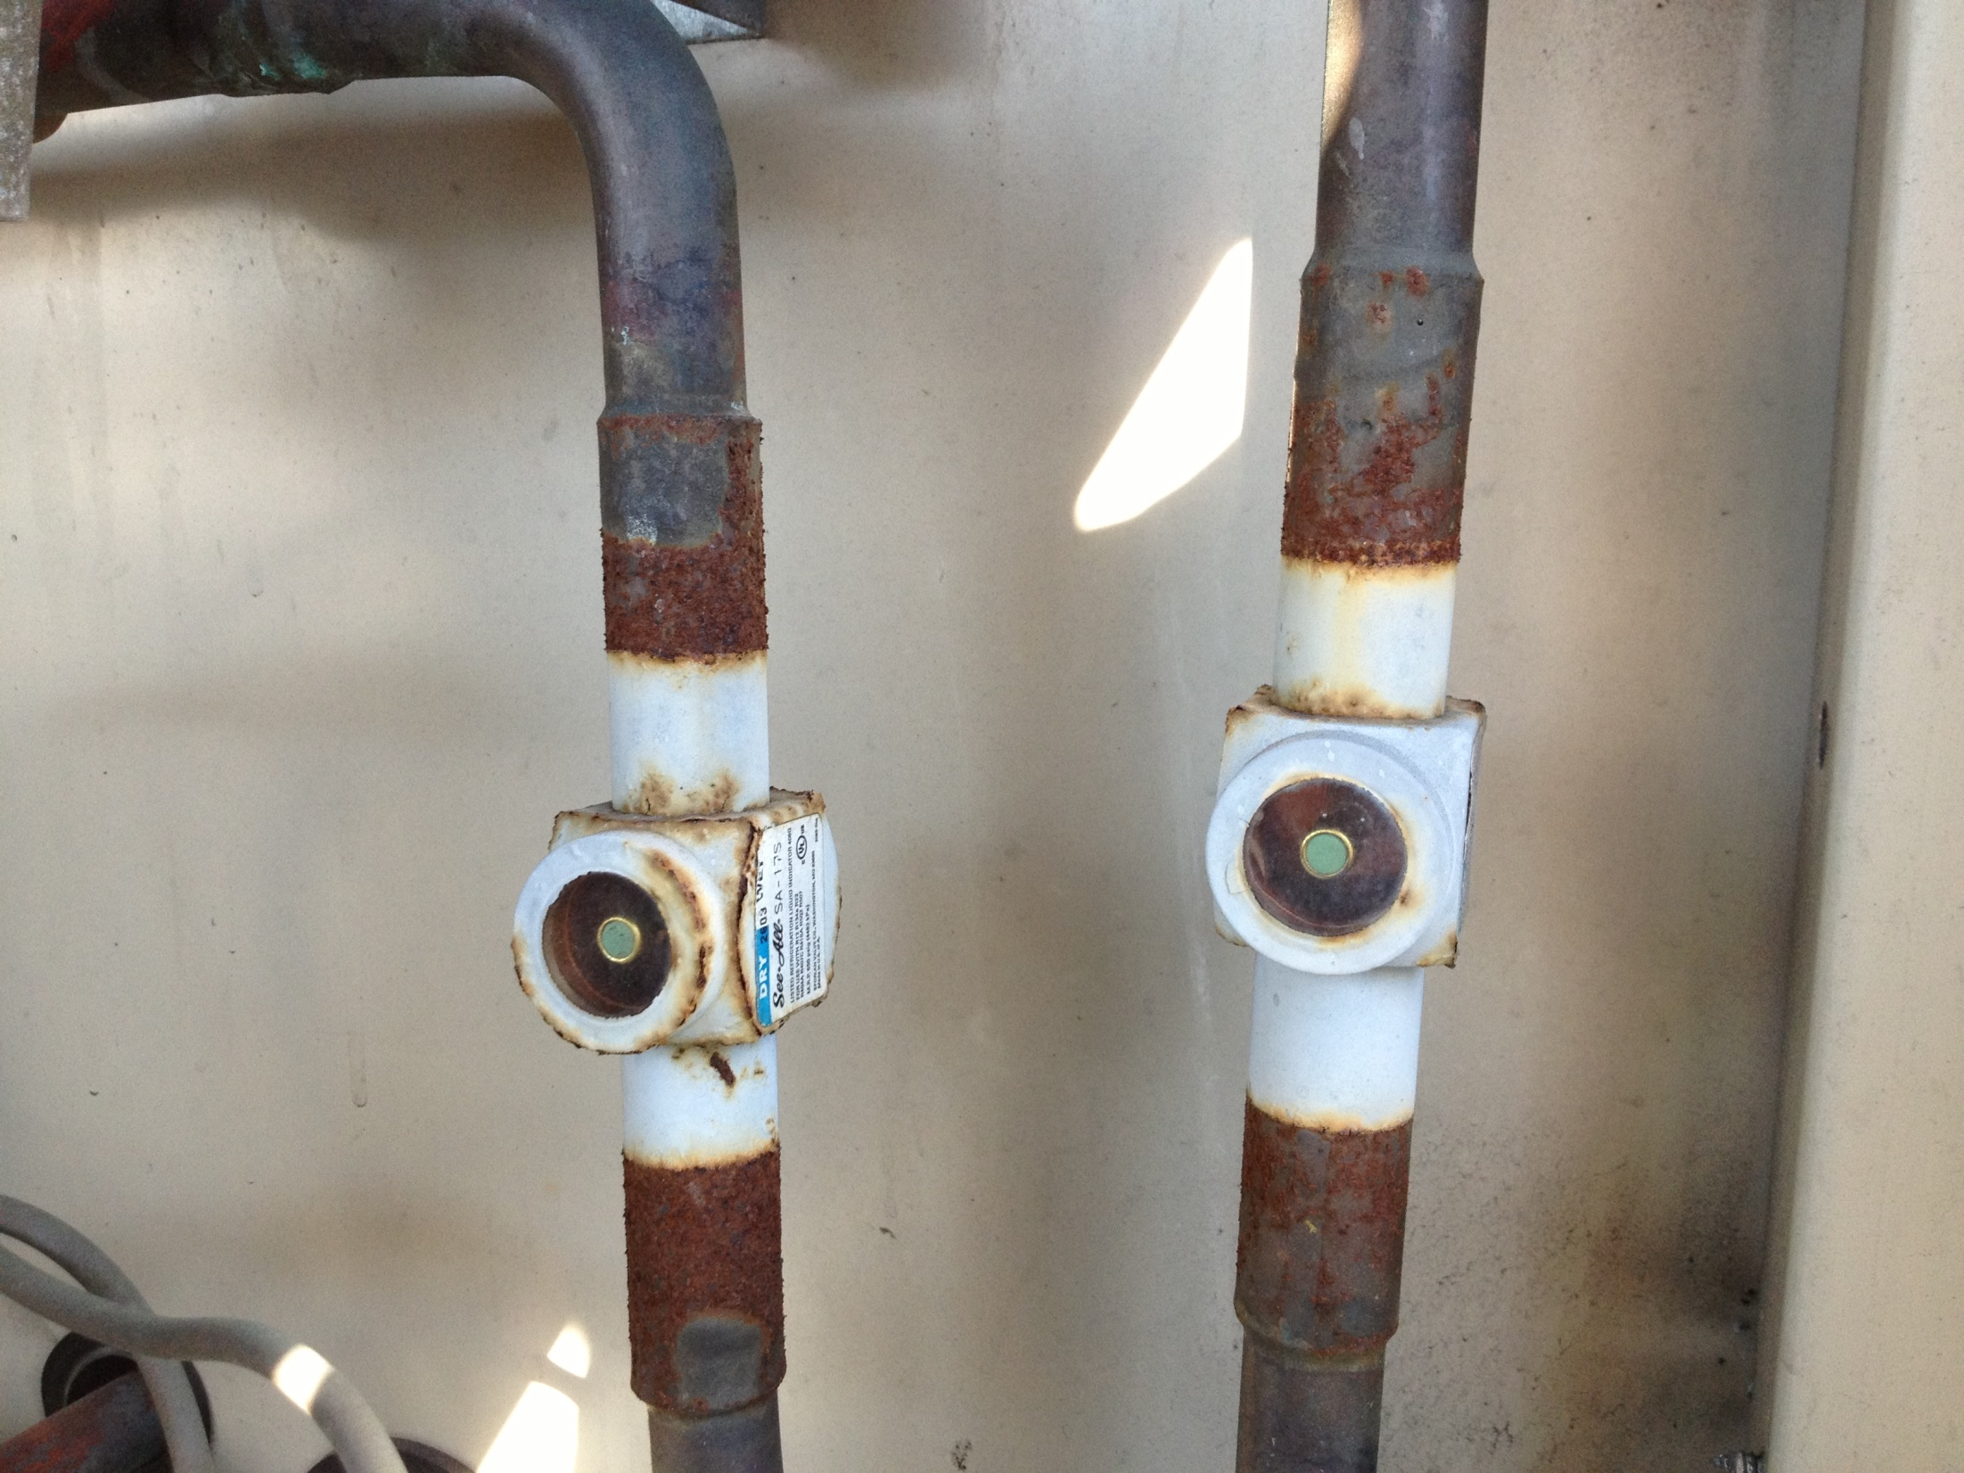
A Refrigerant Sight Glass

Slide 52
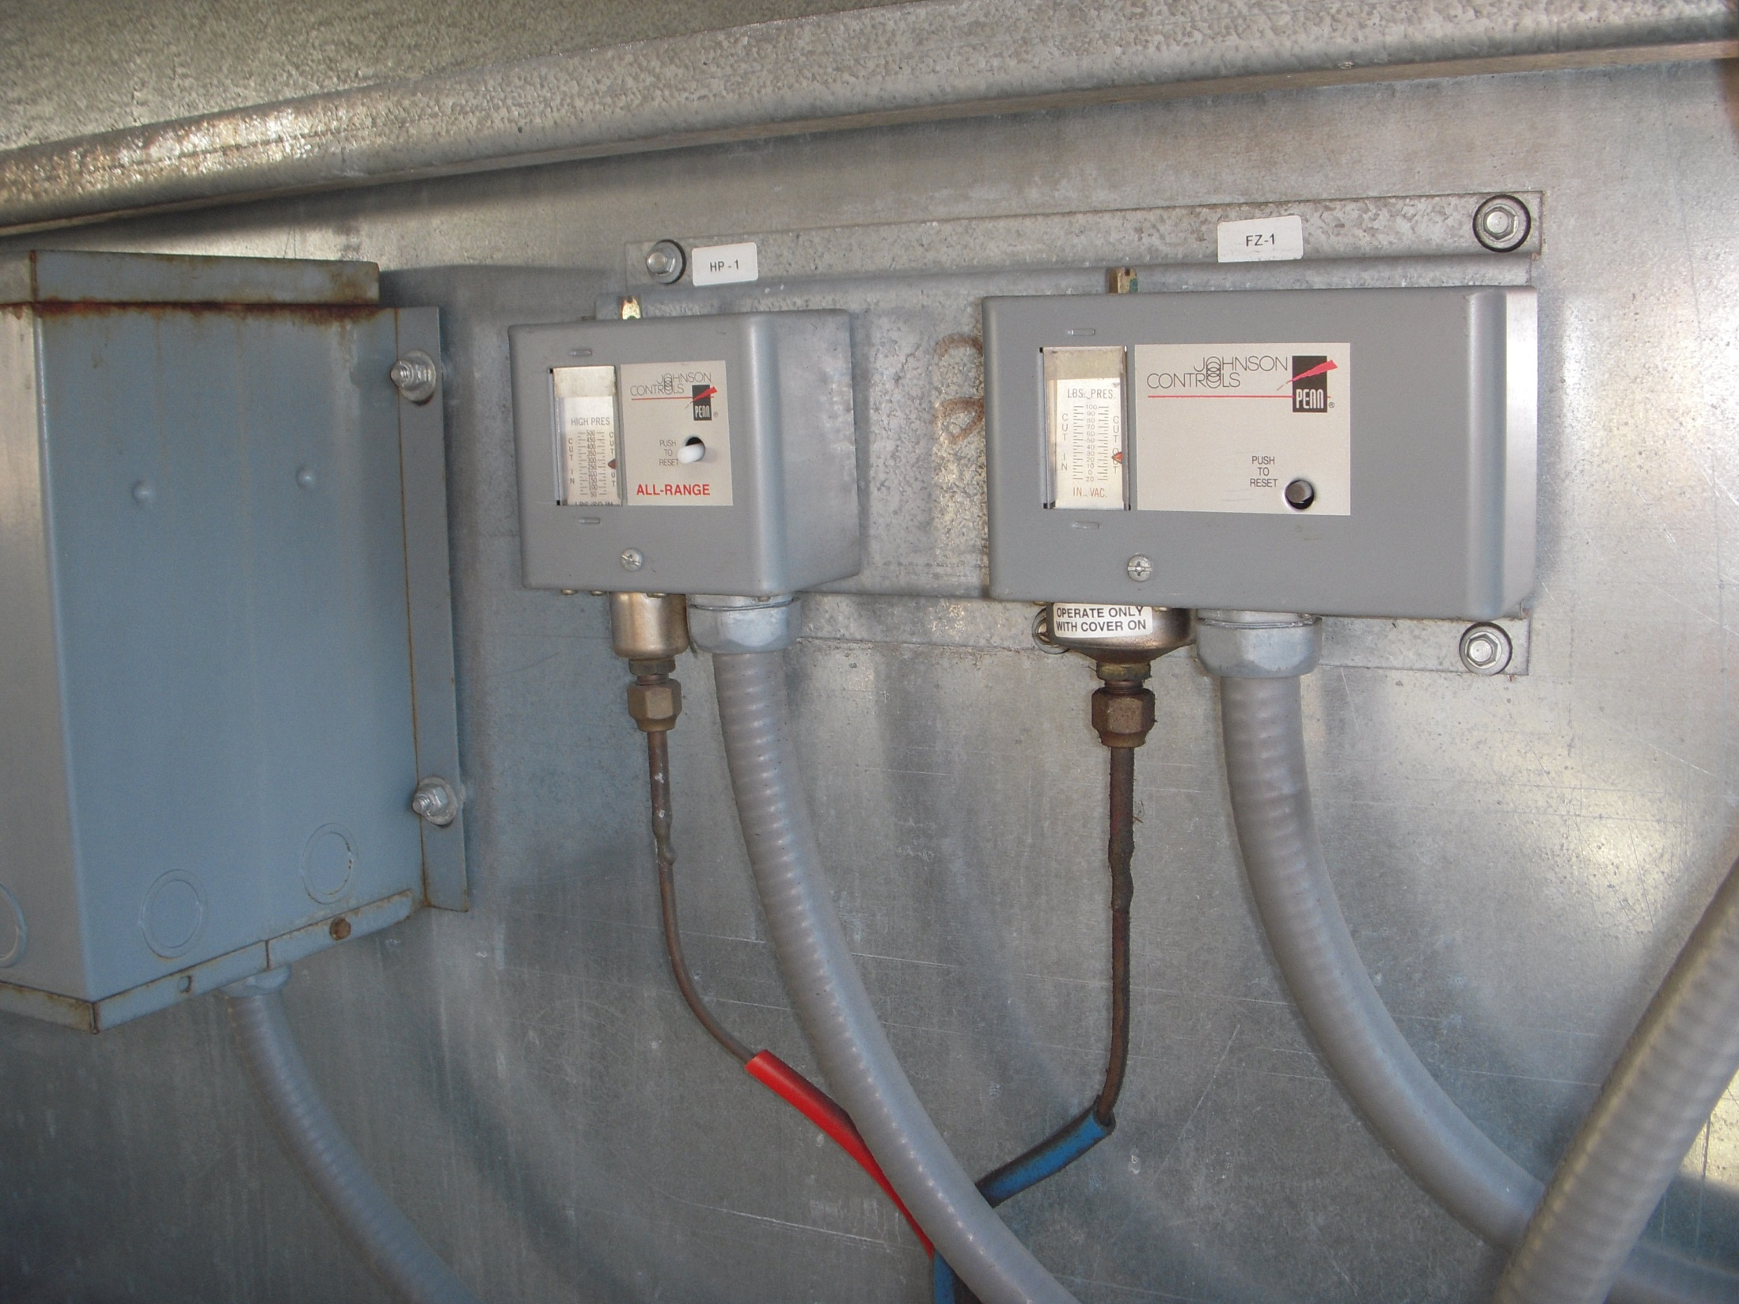
Typical Control Switches

Slide 53
Adding Hot Gas Bypass
Hot Gas Solenoid
Hot Gas Regulator

Slide 54

Hot Gas Bypass Lines
Hot Gas Solenoid Valve
Service Valve
Hot Gas Regulator

Slide 55
Hot Gas Connections to the Evaporator

Slide 56
Let’s Review

Slide 57
Name the Parts in the Diagram on the Next Slide

Slide 58
A
B
G
C
D
F
E

Slide 59
Name the Parts in the Diagram on the Next Slide
Air Cooled Condenser
Reciever
Liquid Line Solenoid Valve
Expansion Valve
Evaporator
Compressor
Hot Gas Solenoid Valve (Right) and Hot Gas Regulator (Left)

Slide 60
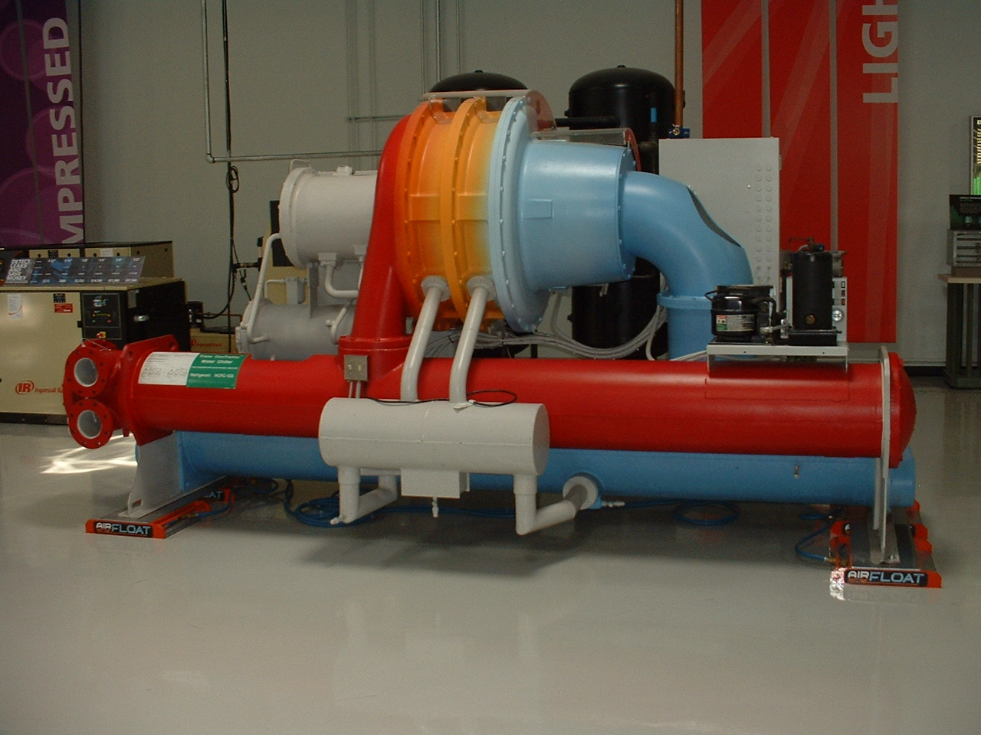
A Water Cooled Centrifugal Chiller

Slide 61
Same Cycle, Larger, Centrifugal vs. Screw Compressor, Water vs. Air Cooled

Slide 62
A Typical Water Cooled Vapor Compression Cycle Chiller
Condenser
3 Stage Centrifugal Compressor
CW Supply and Return
Metering Orifices
Evaporator
Economizer
CHW Supply and Return

Slide 63
Try Your Hand At Identifying the Parts (Answers Follow)

Slide 64
A Water Cooled Centrifugal Chiller
2 ?
3 ?
1 ?
5 ?
6 ?
4 ?
7 ?
8 ?
9 ?

Slide 65
A Water Cooled Centrifugal Chiller
Three Stage Centrifugal Compressor
Controls
Motor
Suction Elbow
Purge Pump
Lubrication System
Condenser
Economizer
Evaporator

Slide 66
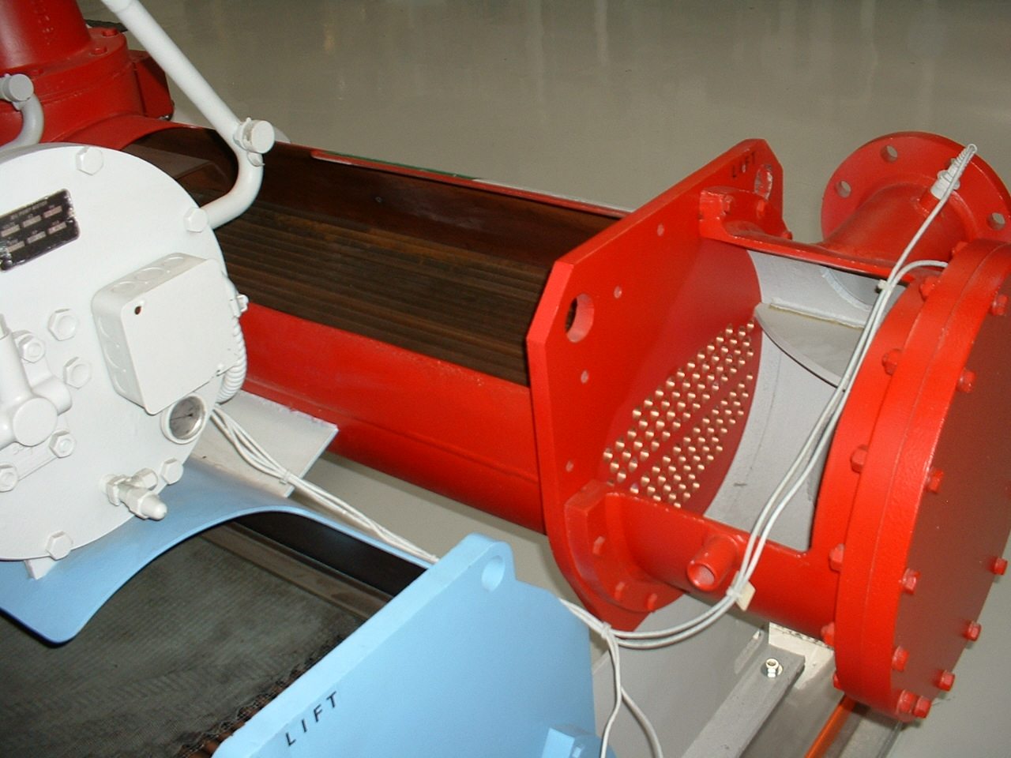
Inside the Condenser
Temperature Sensor
Tubes
Baffle Plate
Tube Sheet
Water Box; Marine Head Type

Slide 67
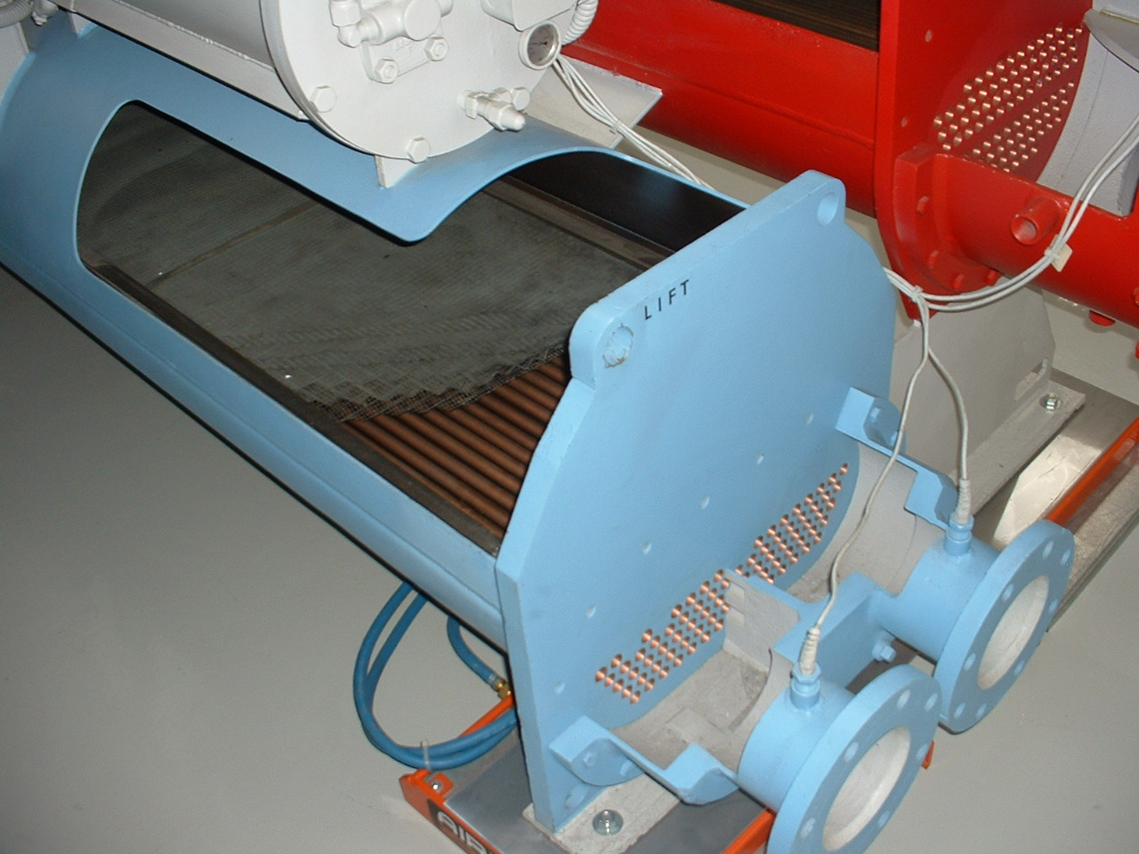
Inside the Evaporator
Oil Sump and Pump
Eliminators

Slide 68
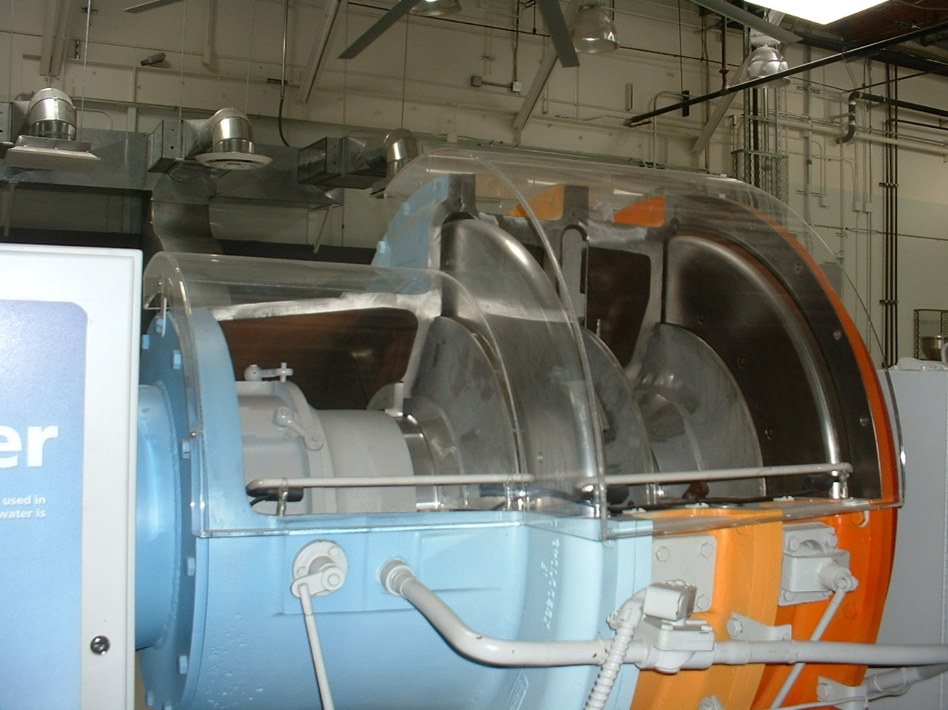
Inside the 3 Stage Compressor

Slide 69
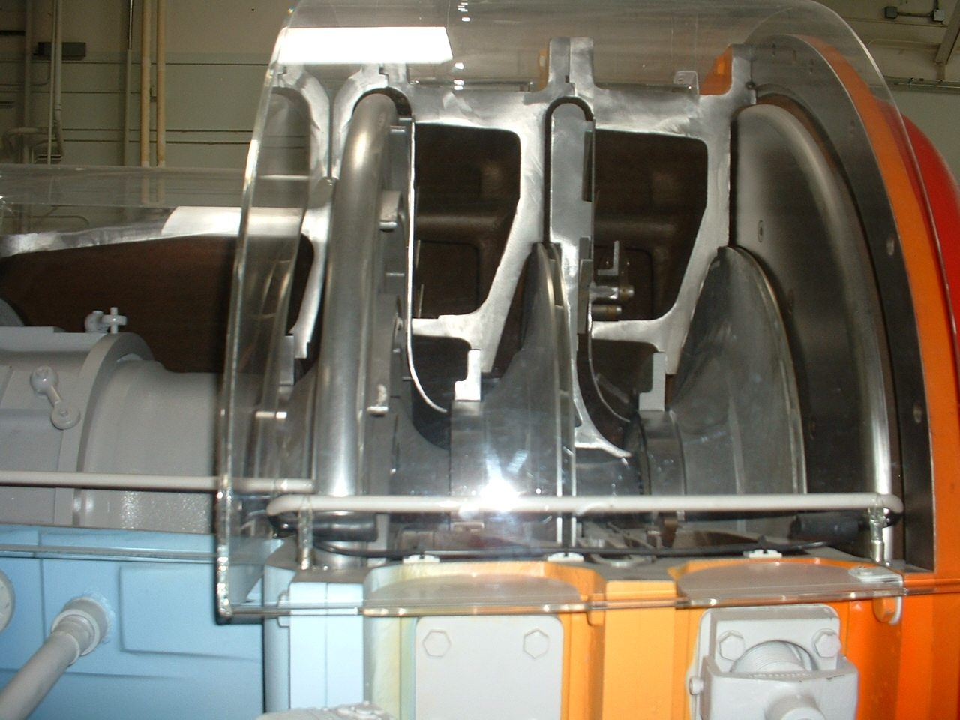
Diffuser (One per Stage)
Inlet Vane Linkage System
Refrigerant Flow Through a Typical Compressor Stage
Impeller (One per Stage)

Slide 70
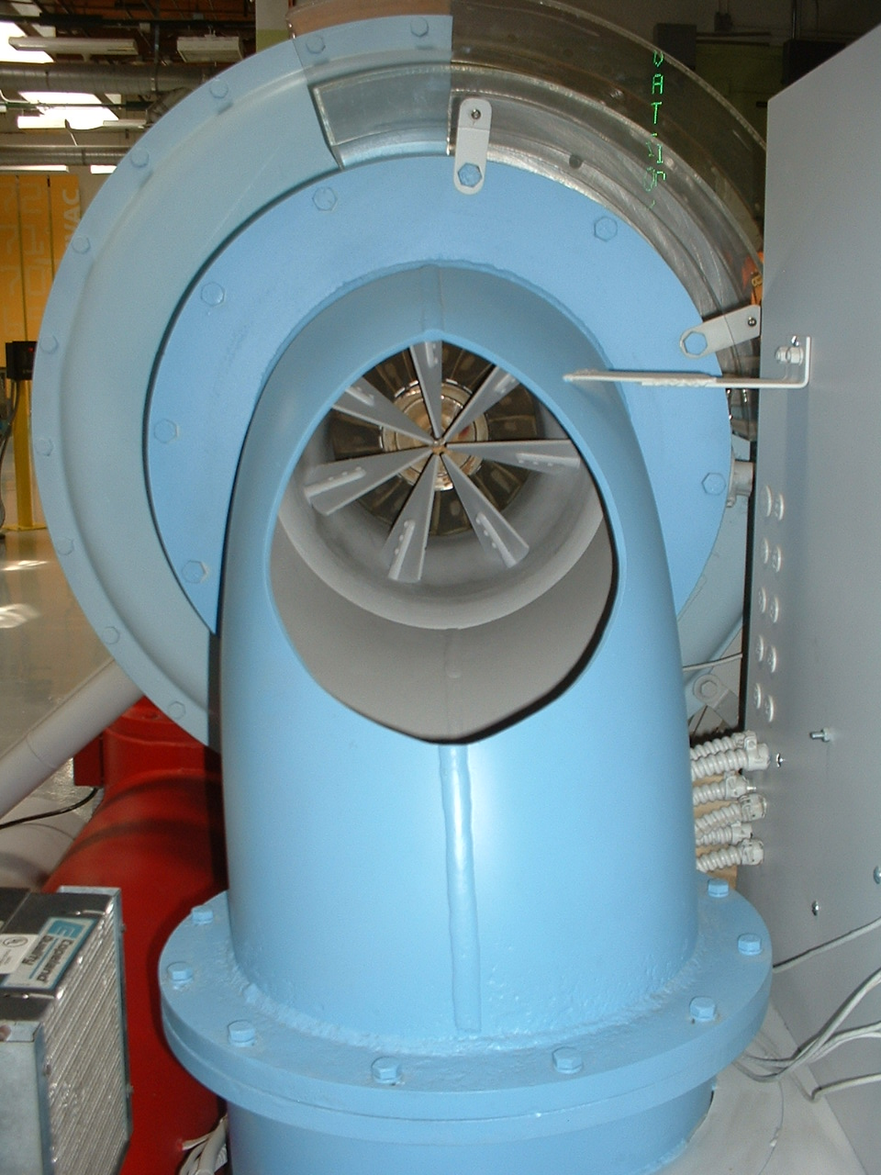
Inlet Vanes and Suction Elbow

Slide 71
Adding Hot Gas Bypass
Condenser
3 Stage Centrifugal Compressor
CW Supply and Return
Metering Orifices
Hot Gas Bypass Valve
Evaporator
Economizer
CHW Supply and Return

Slide 72
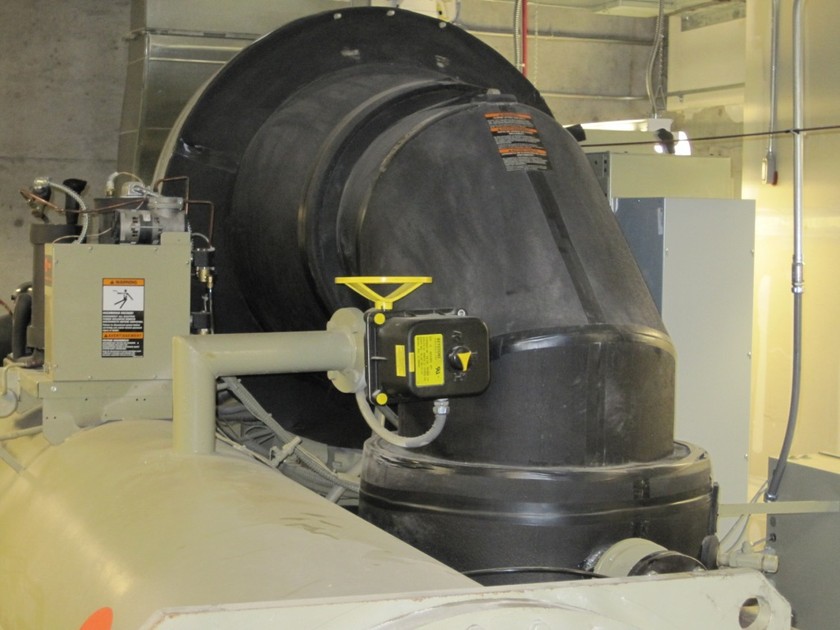
Compressor
Suction elbow
Hot gas valve and piping
Traditional condenser

Slide 73
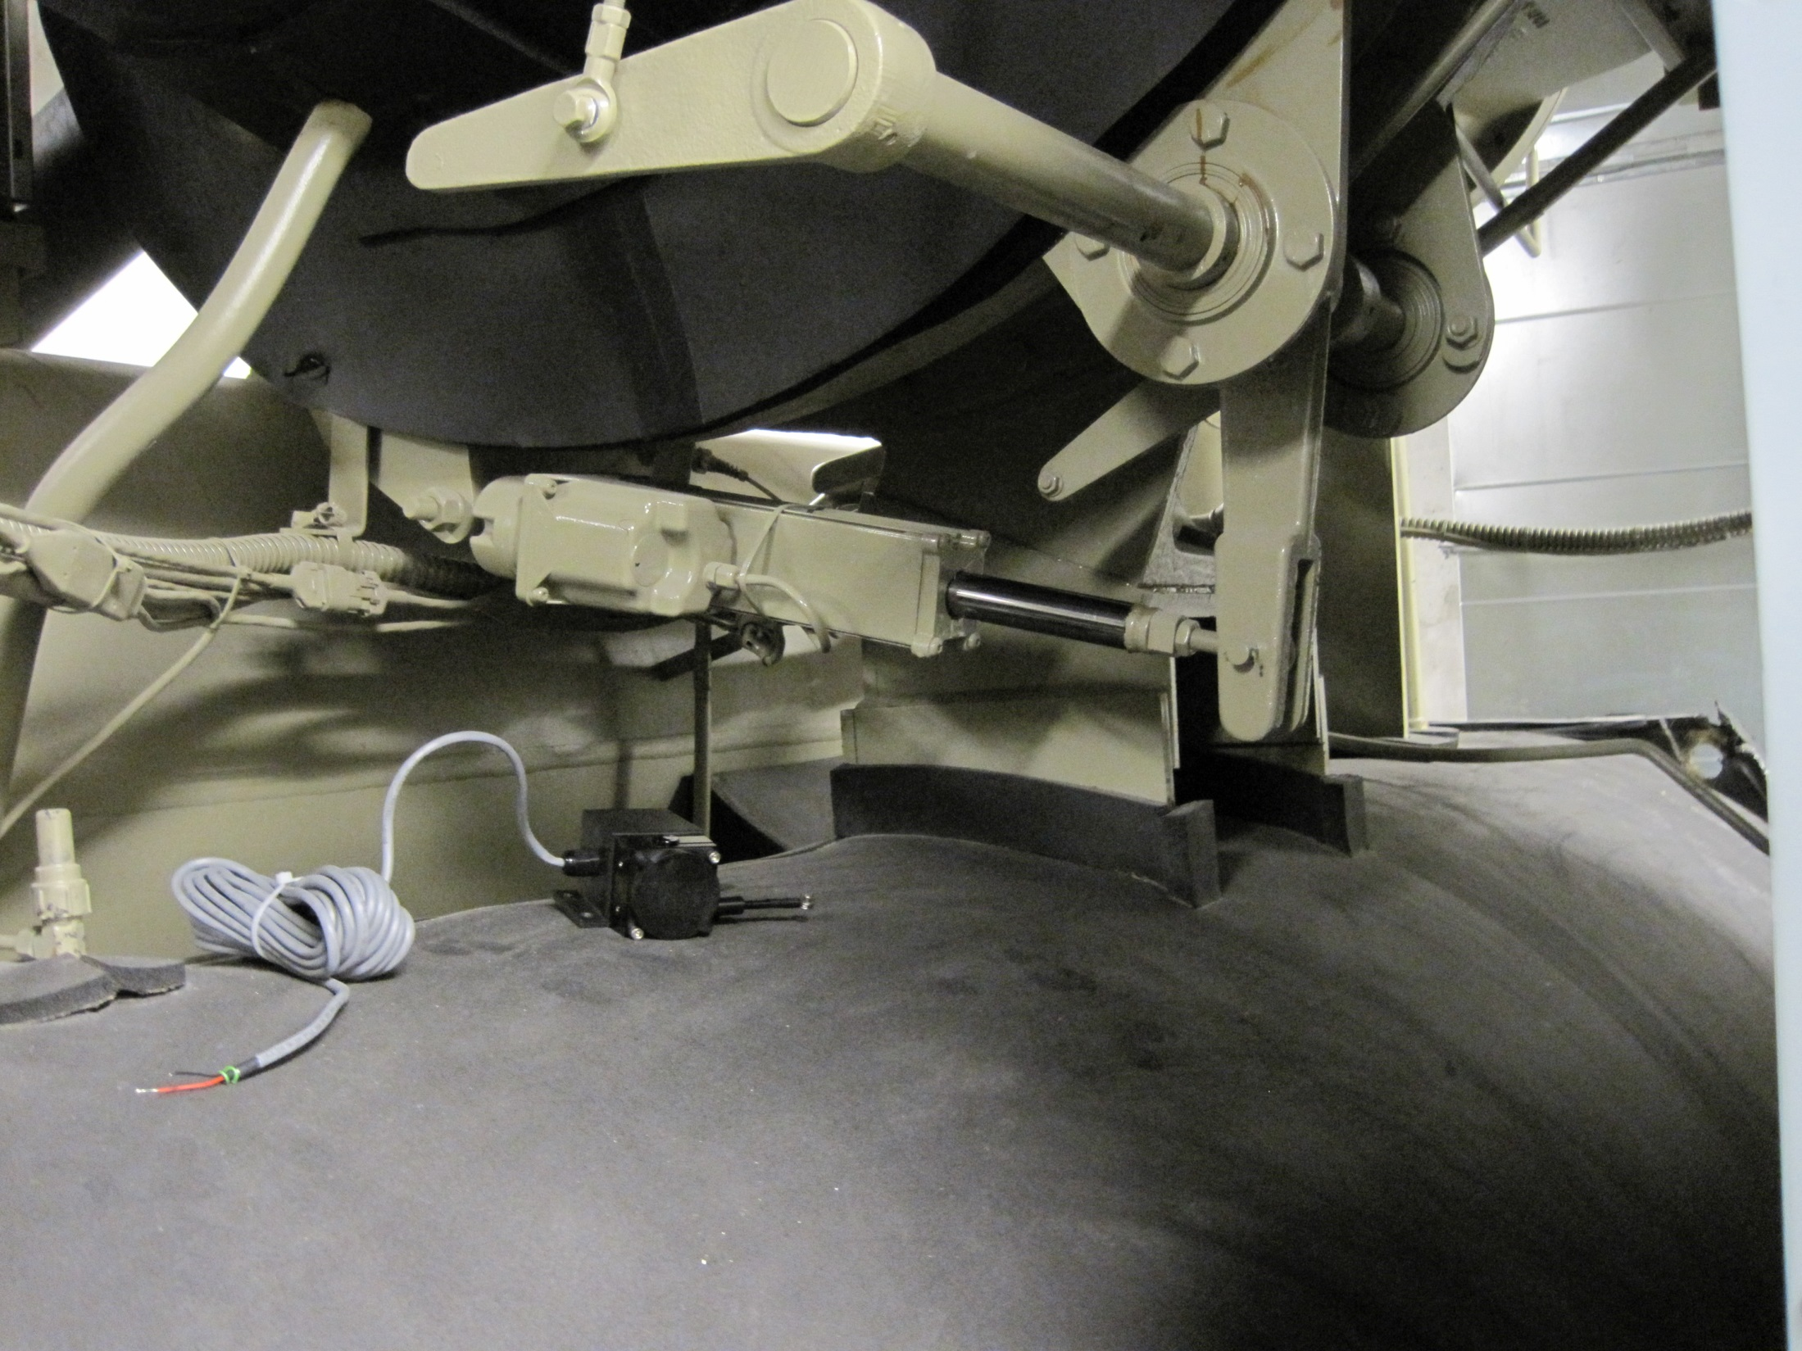
Logging a Centrifugal Chiller’s Inlet Vanes and Hot Gas Bypass

Slide 74
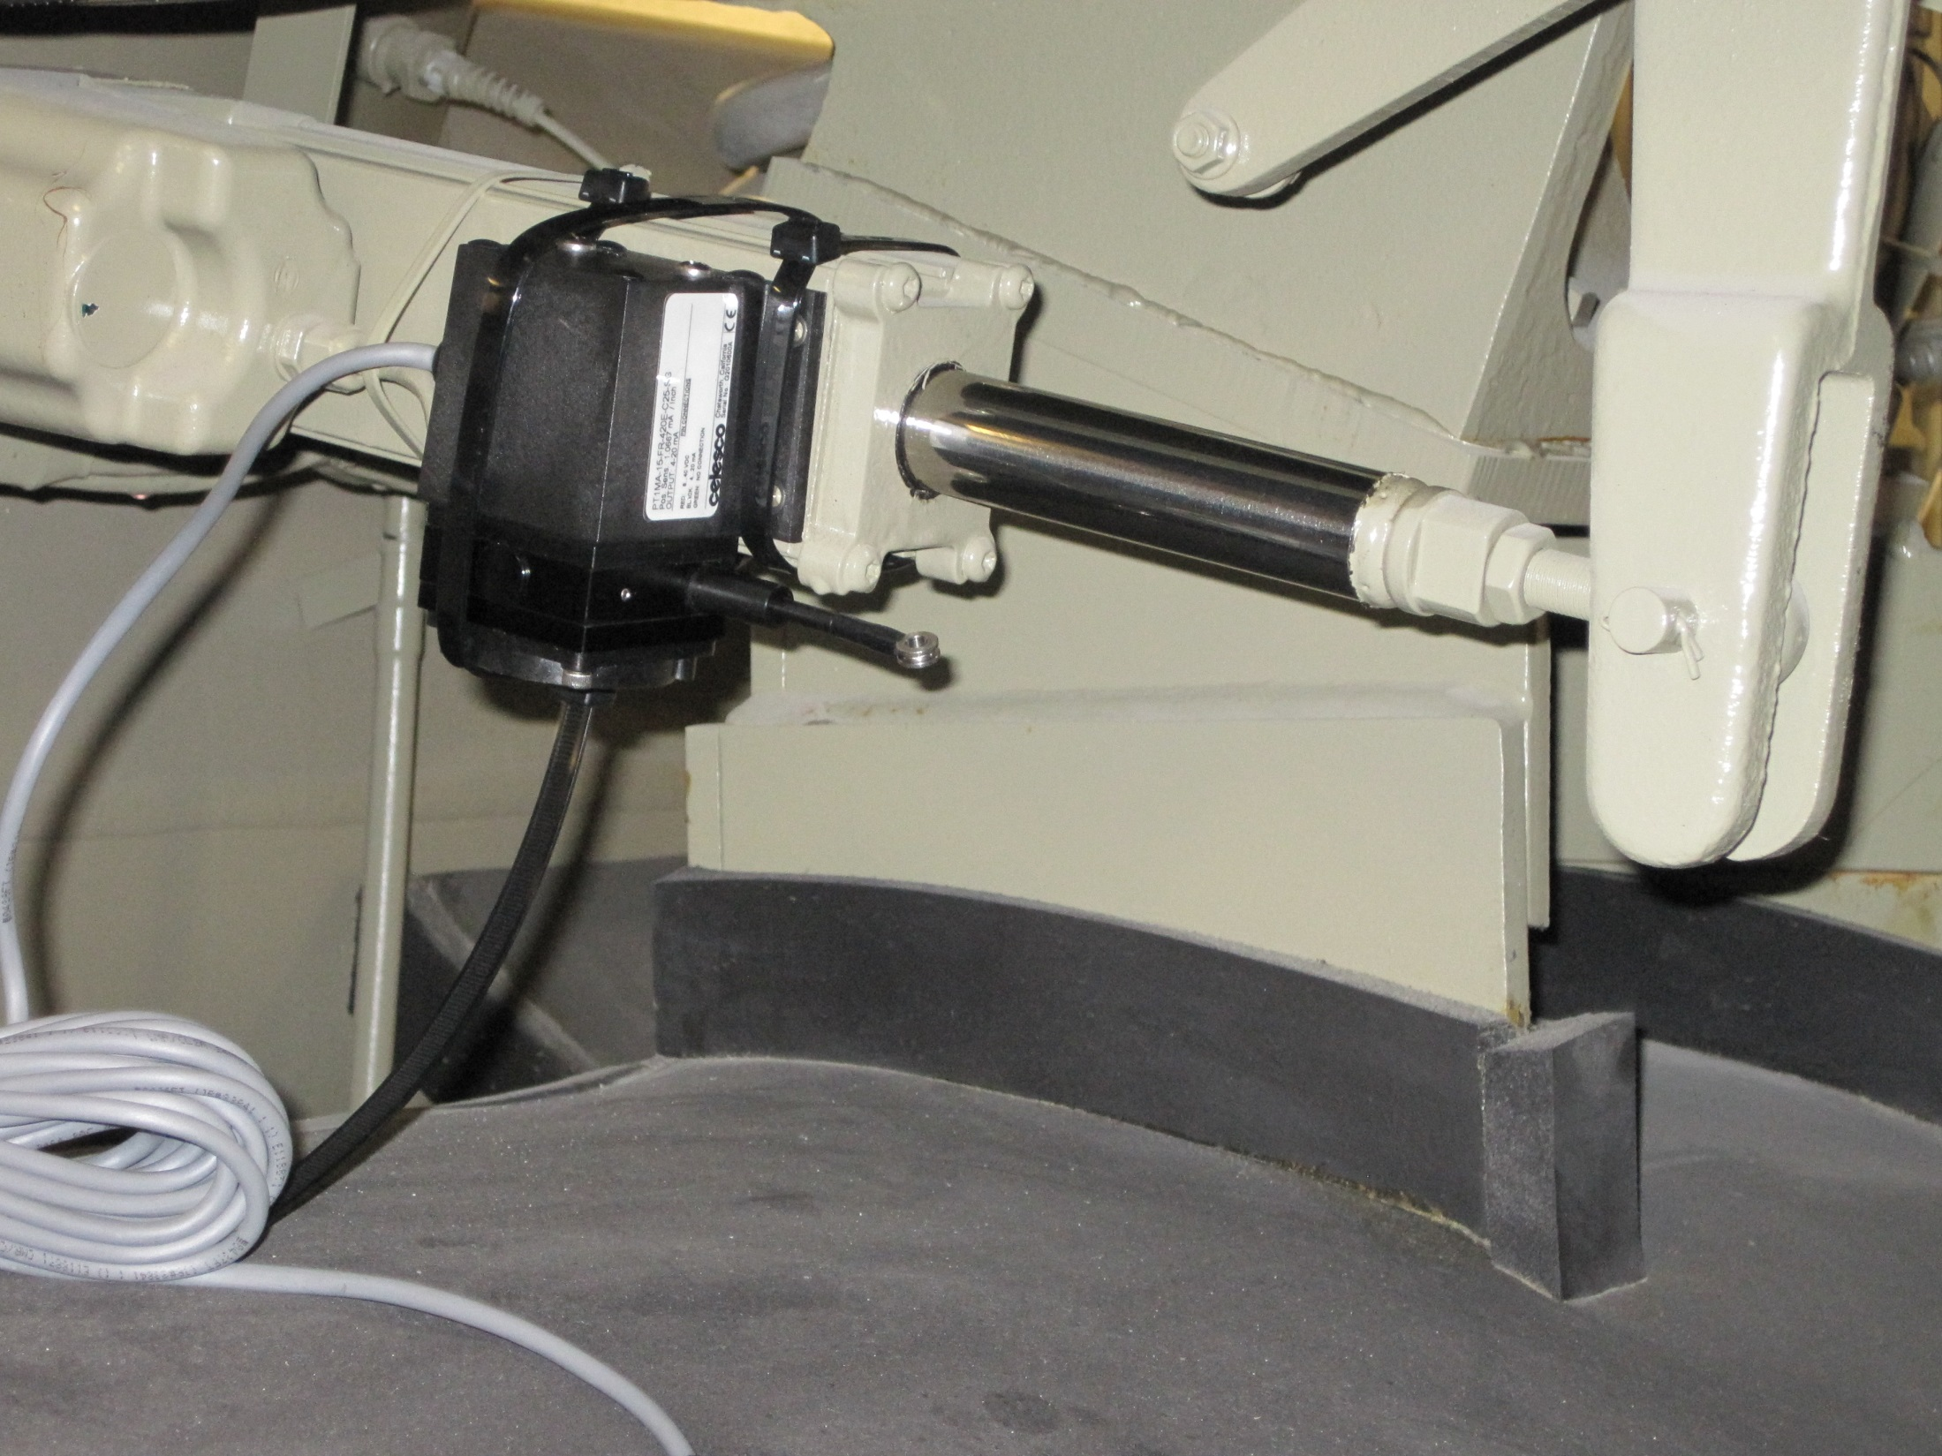

Slide 75
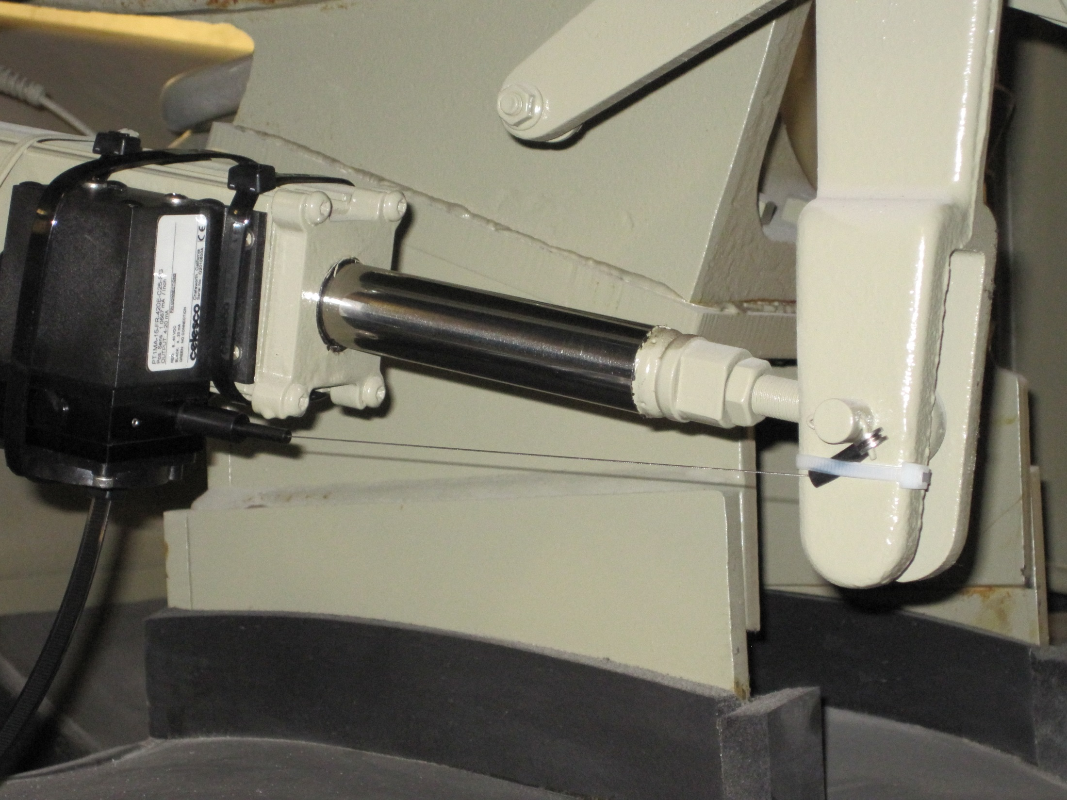

Slide 76
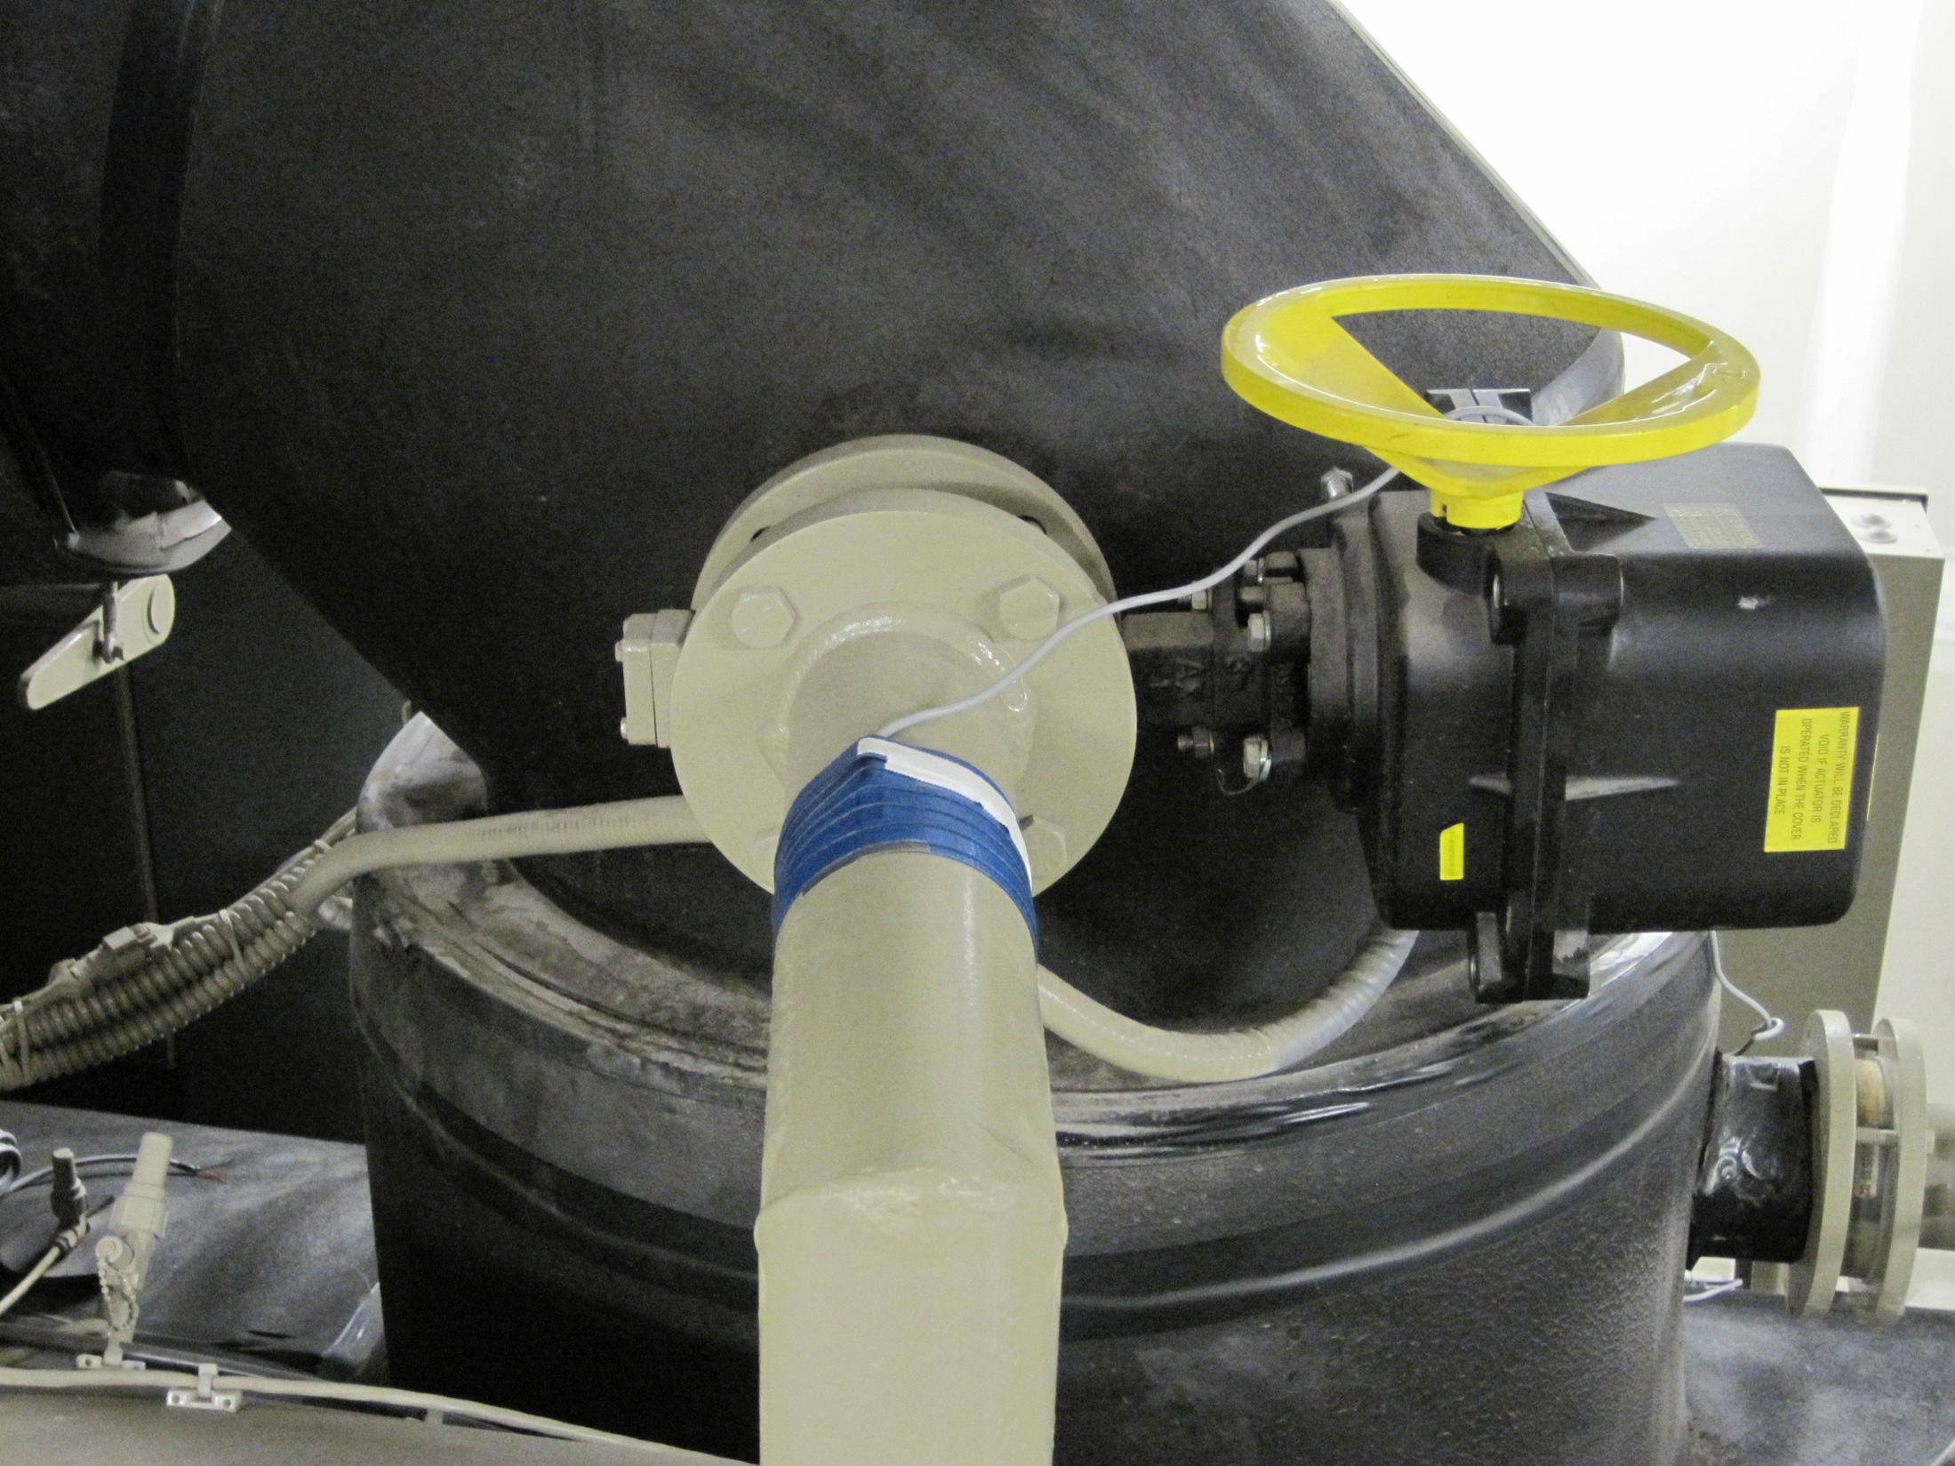

Slide 78
Adding “Free Cooling”
Condenser
3 Stage Centrifugal Compressor
CW Supply and Return
2 Position Valve (Typical of 2; Open for Free Cooling)
Hot Gas Bypass Valve
Evaporator
Economizer
CHW Supply and Return

Slide 79
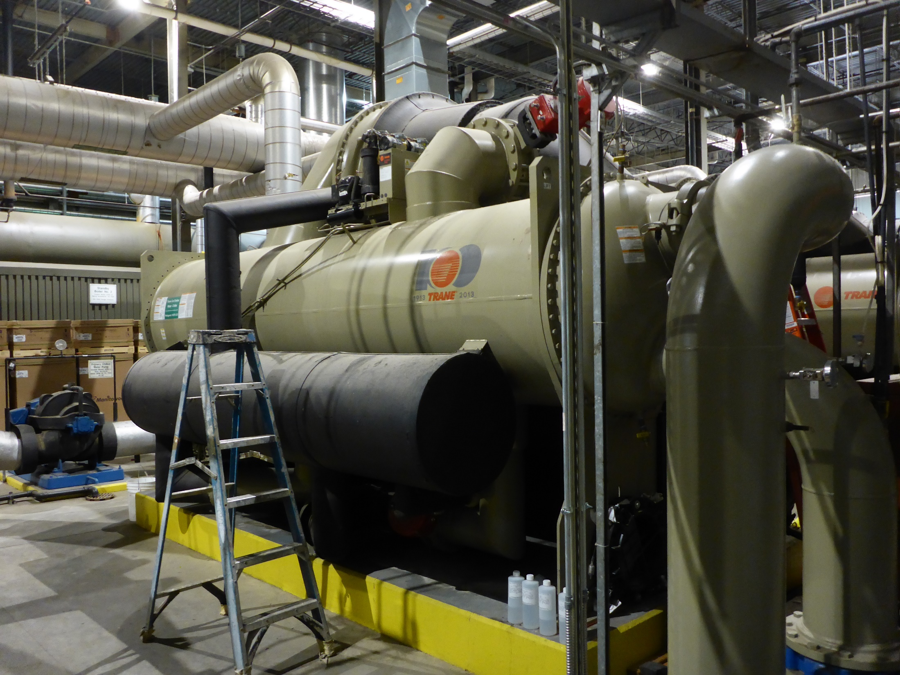
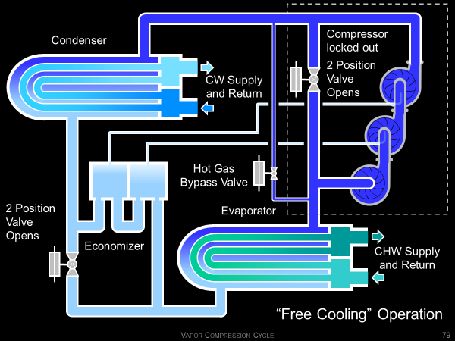
“Free Cooling” Operation
Condenser
Compressor locked out
2 Position Valve Opens
CW Supply and Return
Hot Gas Bypass Valve
2 Position Valve Opens
Evaporator
Economizer
CHW Supply and Return

Slide 80
“Free Cooling” Operation
Condenser
Compressor locked out
2 Position Valve Opens
CW Supply and Return
Hot Gas Bypass Valve
2 Position Valve Opens
Evaporator
Economizer
CHW Supply and Return

Slide 81
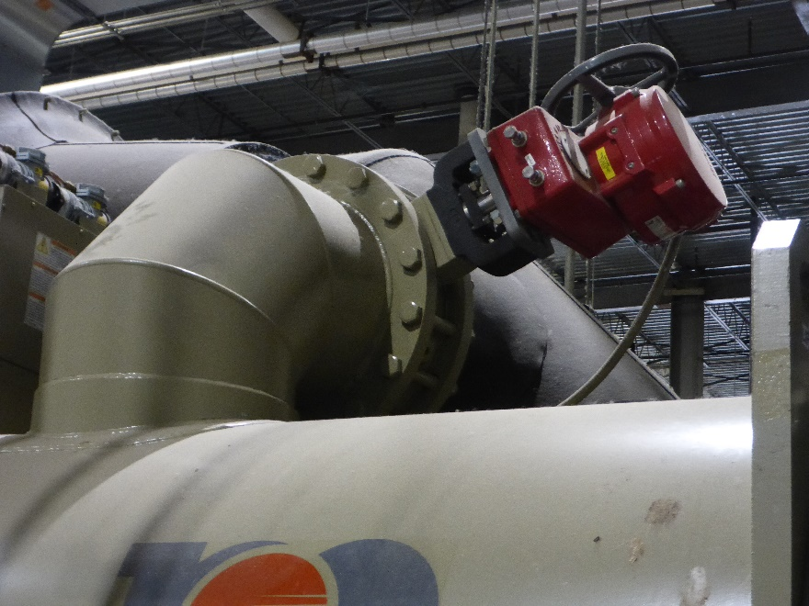

Slide 82
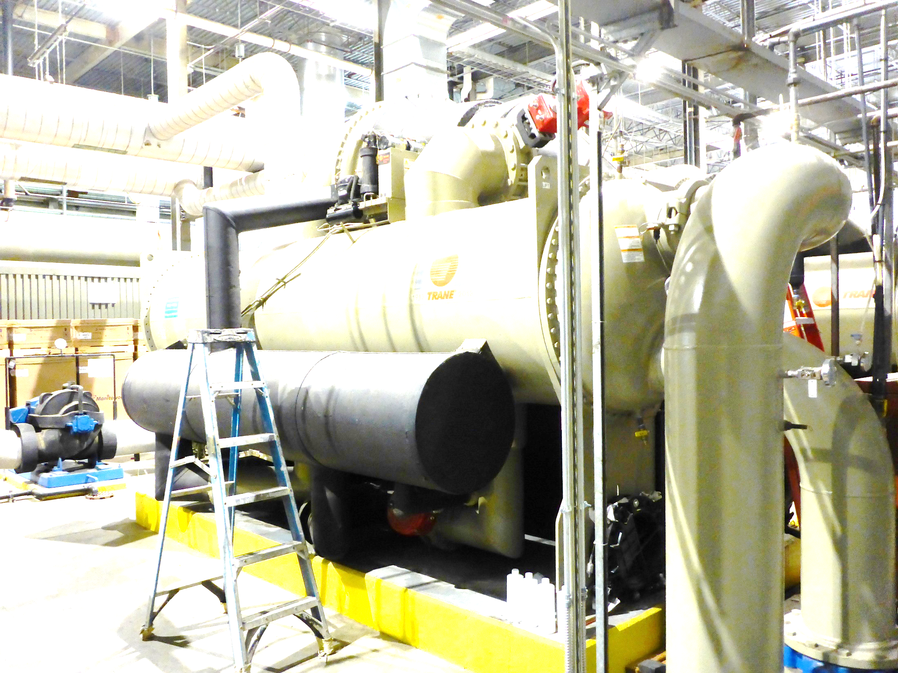
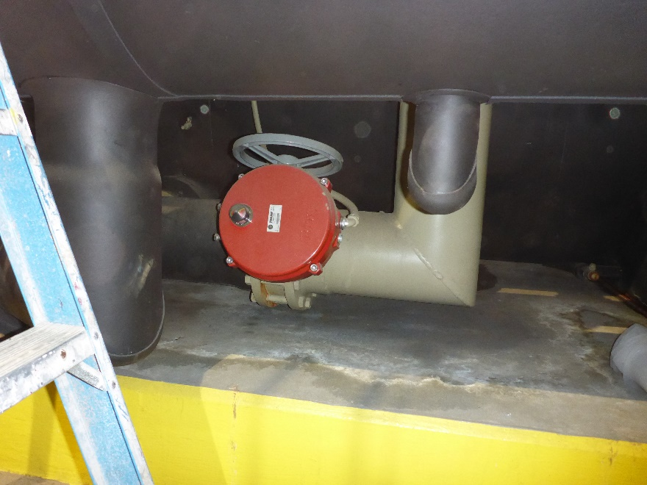

Slide 83
A Heat Recovery Centrifugal Chiller
The chiller in the following slide has a second condenser tube bundle that is piped to the heating hot water system. This allows the hot gas off of the compressor to be used to generate hot water for reheat loads prior to having its heat rejected to the cooling tower via the traditional condenser.

Slide 84
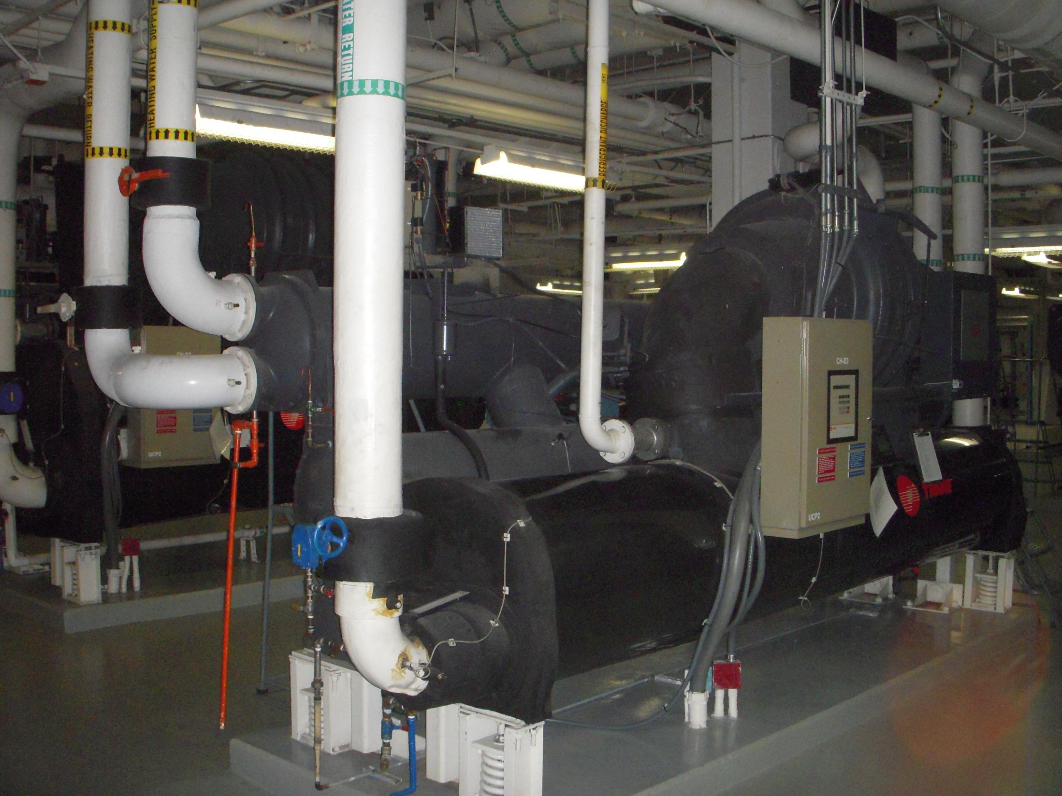

Slide 85
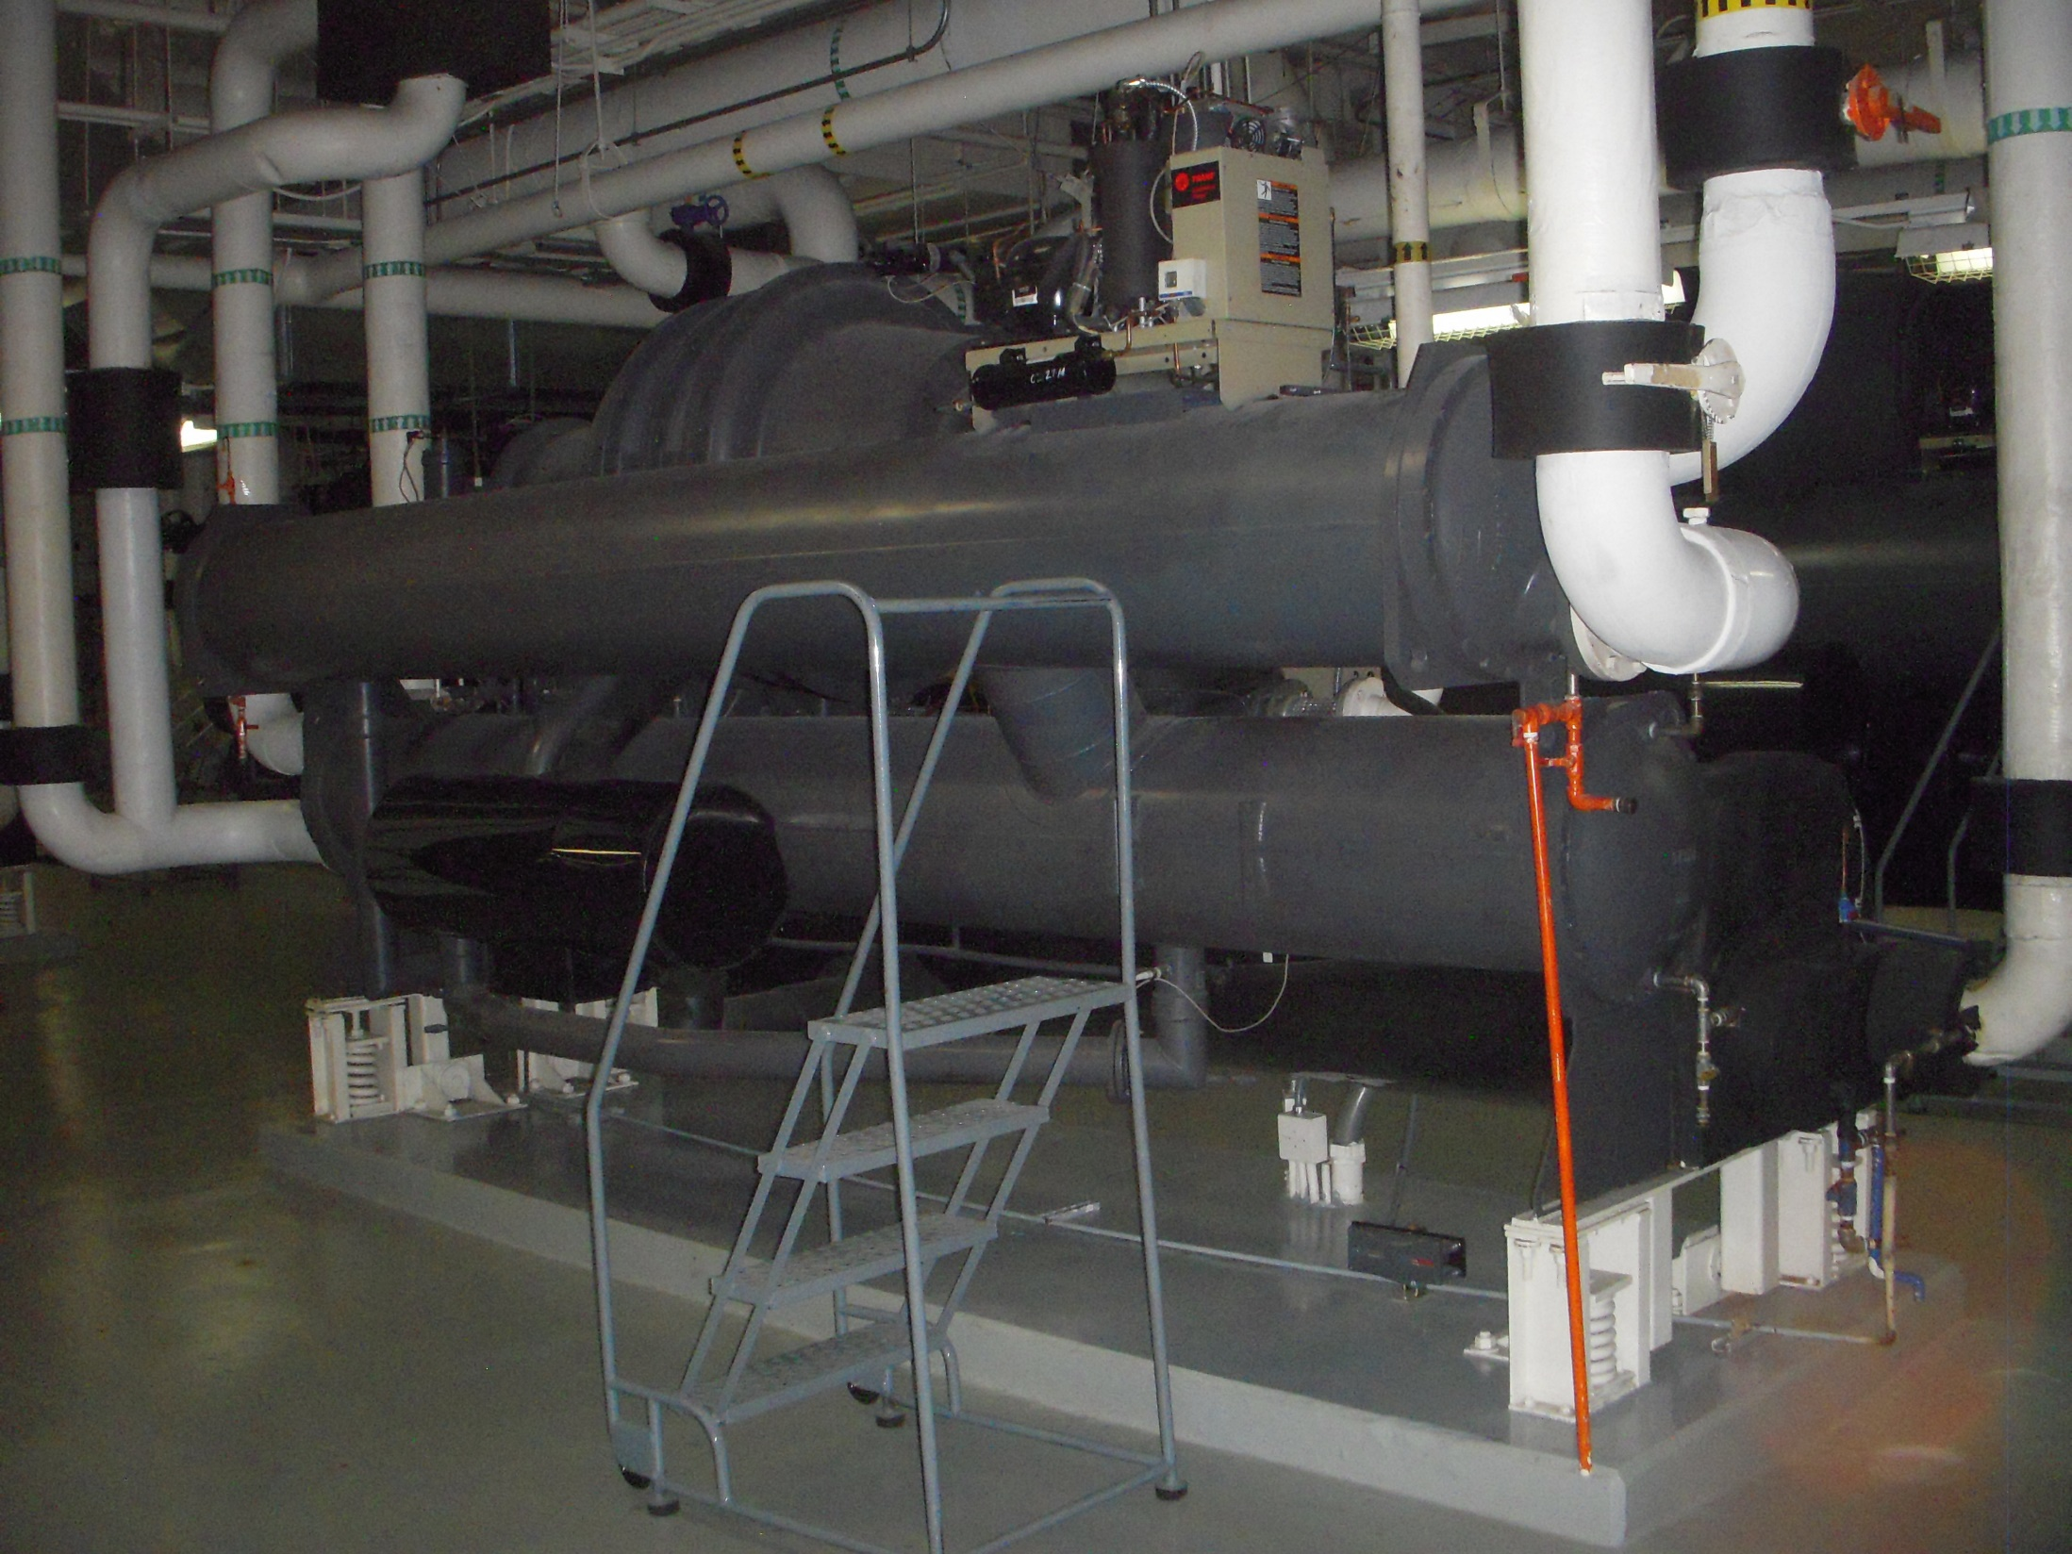

Slide 86
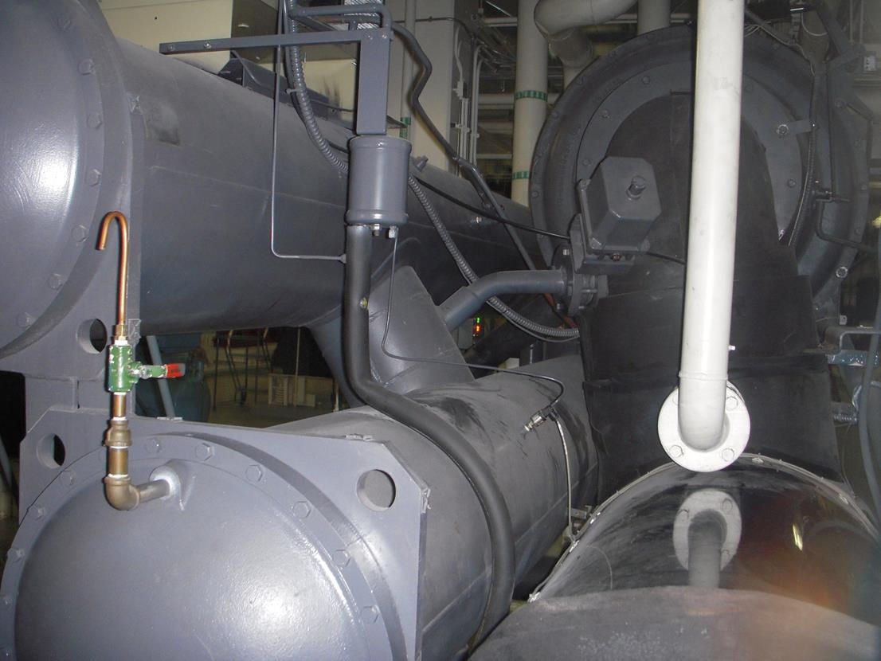

Compressor
Hot gas valve and piping
Suction elbow
Heat recovery condenser
Traditional condenser
Evaporator

